Slide 1
Introduction to Web Development Part 1: Http – TCP/IP Client/Server – Rest Proxy, Gateway, Ng serve
arnaud.nauwynck@gmail.com
Course Esilv 2023
This document: https://github.com/Arnaud-Nauwynck/presentations/web/intro-web-dev-part1-http.pdf

Slide 2
Outline
http protocol, sample step by step on top of TCP-IP
http Client Request – Server Response principles. Header extensibility
Minimalist client/server application (java, then springboot)
Typologies of servers static pages server, dynamic server-side pages, Rest API, Gateway, Proxy, angular « ng serve »

Slide 3
Network Protocols: TCP-IP, DNS, Http
What happen on the network
when you type in your Browser
« https://www.google.com»
« https://github.com/Arnaud-Nauwynck?tab=repositories»
« http://localhost:8080/bar?query=xyz#baz»
??

Slide 4
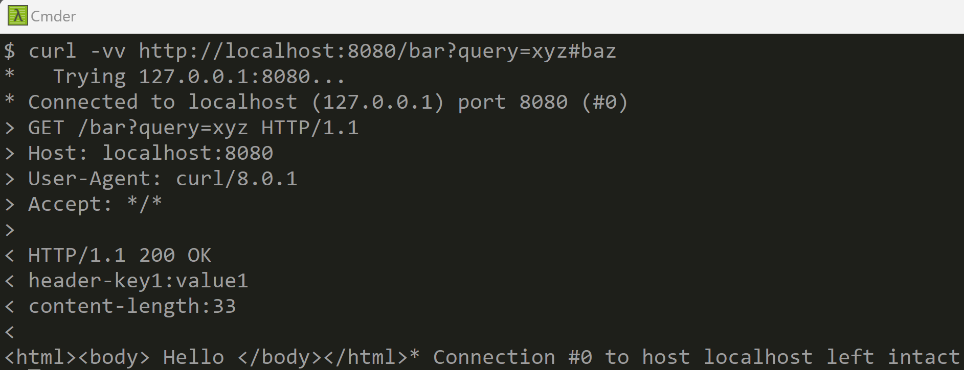
Guessed? « http://localhost:8080» is NOT part of path « #bar » is skipped
Interpreted because http is over TCP-IP
Interpreted by web browser (for page paragraph « #anchor »)

Slide 5
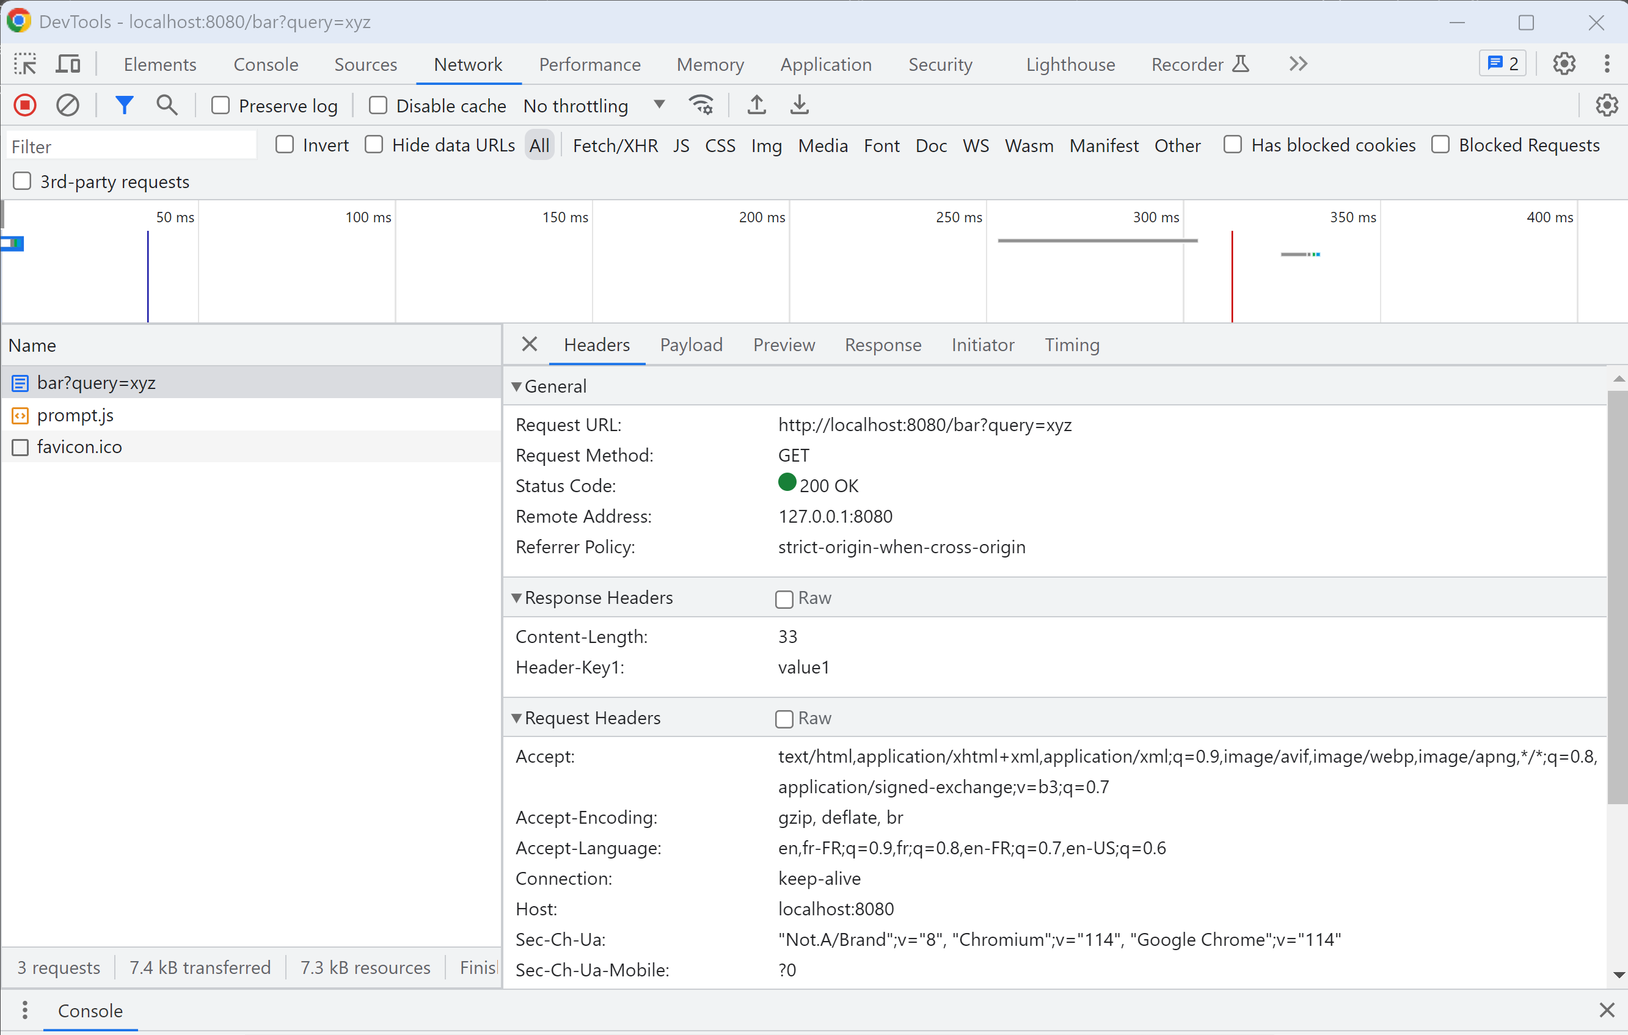
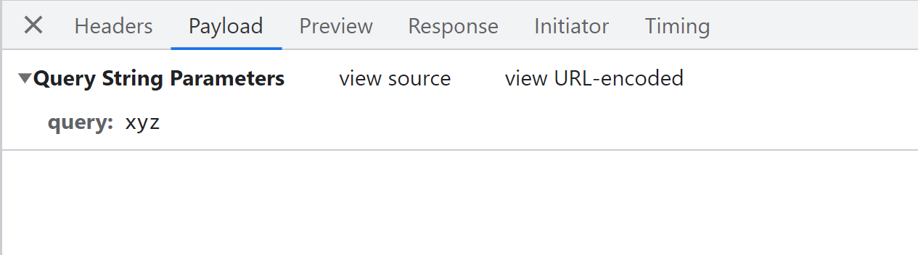
F12 : Chrome Debugger Tool > Network

Slide 6
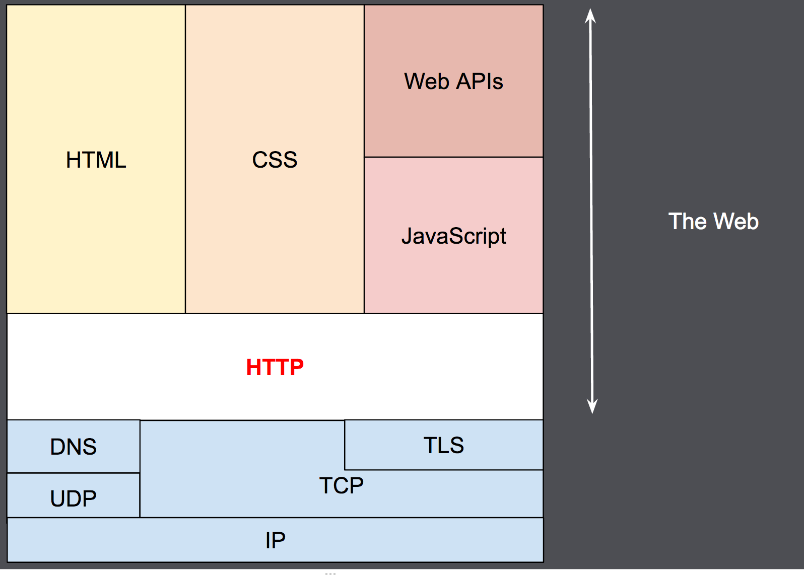
https://developer.mozilla.org/en-US/docs/ Web/HTTP/Overview

Slide 7
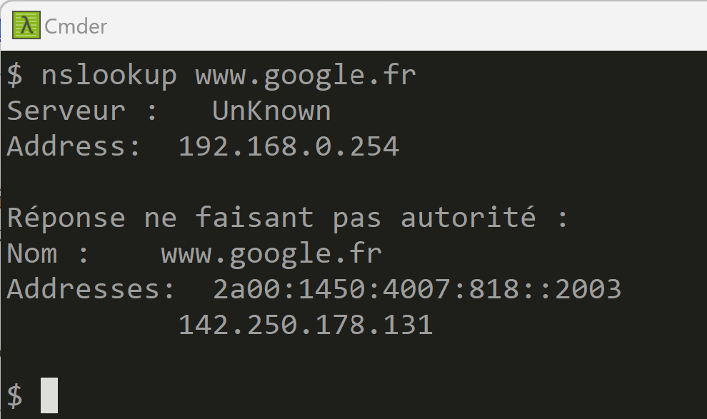
Step 1: URL is parsed, DNS resolved
https://www.google.fr:443/bar?query=xyz#baz
DNS: resolve hostname -> IP address
Equivalent to
$ nslookup www.google.fr

Slide 8
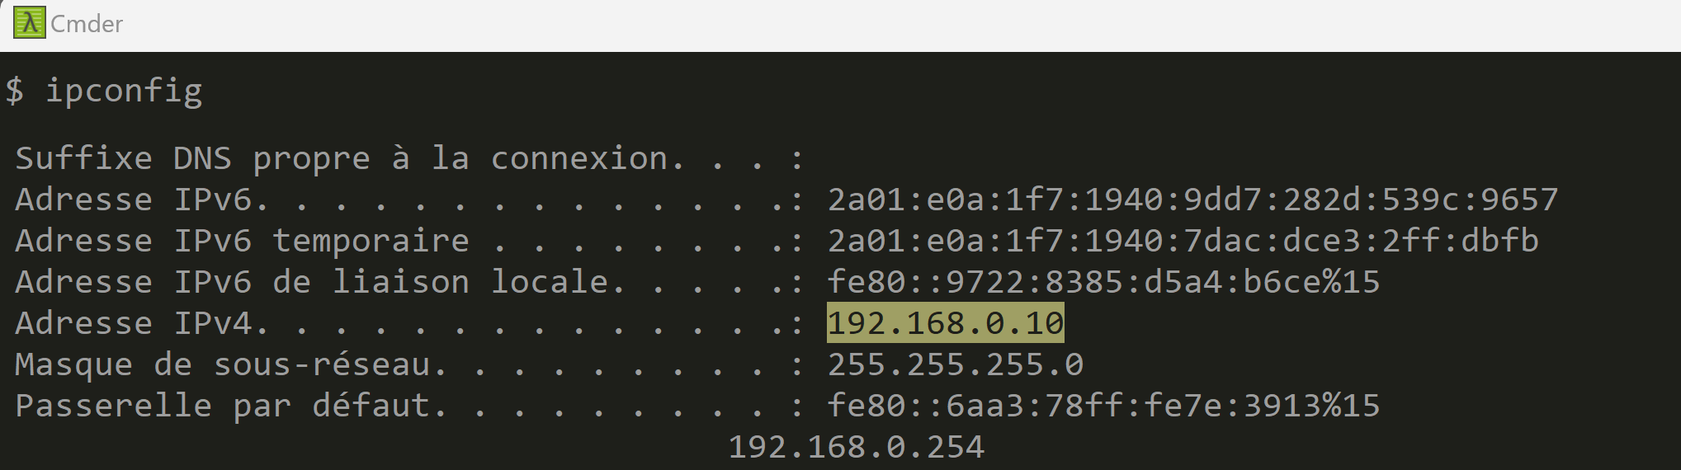
Step 2: resolve local IP address + gateway address + create TCP-IP Socket
Connection
from: localhost -> to: www.google.com
TCP-IP socket (=4 values in IP packets)
From IP: 192.168.0.10
fromPort:24352 (random)
To IP : 142.250.178.131
toPort: 443

Slide 9
Step 3: TCP-IP socket connection
Client-Side System calls:
« s = new socket(..) »
« s.connect() »
Server-Side System calls:
« ss = new ServerSocket() »
« ss.bind(loc,443); »
« s = ss.accept() »
IP packet 1 :
« SYN »
IP packet 2 :
« ACK »
IP packet 3 :
« ACK »
TCP-IP socket opened = duplex communication channels

Slide 10
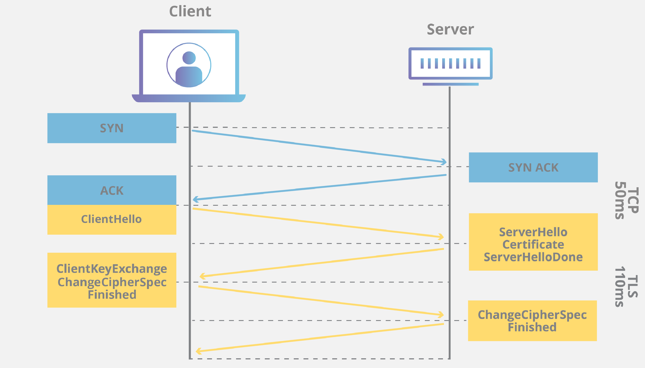
Step 4: https = http + TLS (SSL) => Handshake (generate private+pub key – exchange pub key..)
TCP-IP socket opened = duplex communication channels
Generate private+public key pair
Send certificate
(=public key, signed by others)
check certificate

Slide 11
Step 5 : client write http Request text
Client WRITE request text, then flush socket buffer
Line1 = « GET /path/foo?bar HTTP/1.1 »
Line 2,3…N= http headers:
« key1 : value1 »
« key2 : value2 » « keyN : valueN »
Empty Line: « »
Then : body… N bytes
« binary-content, maybe ascii html, json, image, … »

Slide 12
Step 5 : client write http Request text
Client WRITE request text, then flush socket buffer
Line1 = « GET /path/foo?bar HTTP/1.1 »
Line 2,3…N= http headers:
« key1 : value1 »
« key2 : value2 » « keyN : valueN »
Empty Line: « »
Then : body… N bytes
« binary-content, maybe ascii html, json, image, … »
GET, PUT, POST, DELETE,HEAD,PATCH,…
are http « Method Verbs »
request Path (and query parameters)
are relative to server host
http Request Headers some are standards headers: Host, Content-Type, Accept, ..
http Request Body optional (generally none in GET and DELETE,
one in PUT and POST)

Slide 13
Step 6: Client WAIT response, and do not write any more to socket
possible strategies:
1/ negotiate in http Header to keep socket open, and re-use
2/ half-close the socket on client-side (socket is now read-only)

Slide 14
Step 7 : server write http Response
Server WRITE response text,
then flush socket buffer
Line1 = « HTTP/1.1 200 OK»
Line 2,3…N= http headers:
« key1 : value1 »
« key2 : value2 » « keyN : valueN »
Empty Line: « »
Then : body… N bytes
« binary-content, maybe ascii html, json, image, … »

Slide 15
Step 7 : server write http Response
Server WRITE response text,
then flush socket buffer
Line1 = « HTTP/1.1 200 OK»
Line 2,3…N= http headers:
« key1 : value1 »
« key2 : value2 » « keyN : valueN »
Empty Line: « »
Then : body… N bytes
« binary-content, maybe ascii html, json, image, … »
200,300,301,400,404,500,…
are http « status code»
« status message»
http Response Headers some are standards headers: Content-Type, ..
http Response Body

Slide 16

Step 8: Client read response, close socket

Slide 17
http(s) Protocol Caracteristics
http 1.x protocol is human readable,
( http 2 … encapsulate multiple connections in frames )
http is Simple
http is Stateless (no session)
http is Extensible
https = http over TLS is secure

Slide 18
http protocol: Simple text headers - body
http {method} {/path} HTTP/1.1
header1=value1
…
headerN=valueN
<body>
HTTP/1.1 {statusCode} {statusMessage}
header1=value1
…
headerN=valueN
<body>

Slide 19
HTTP is Stateless
N Calls => create N independent sockets !!!
N http requests !!!
Requests can pass « session » information
in /path/?sessionId={1234567}
in httpHeader: header-sessionId={1234567}

Slide 20
Stateless = Fundamentals for Load-Balancing ( resilience + horyzontal scalability)
http Client
Multiple IP address
For 1 DNS name
Network « LB5 »
Load Balancer
Example: Route53 on AWS
http Server Clusters
Example: Ingress on Kubernetes
You are not alone on Internet
… there can be Billions http clients !!!

Slide 21
Connection latency … HTTP socket re-use
Establishing a https connection is « SLOW »
- Need 3 IP packets for TCP: SYN-ACK-ACK
Then … for TLS Handshake
Socket may be re-used for performance: cf http header « keep-alive »
https://developer.mozilla.org/en-US/docs/Web/HTTP/Headers/Keep-Alive
Cf also Http2: multiplex N simultaneous calls on 1 socket

Slide 22
Http is Extensible !!
Headers can be used both in http Request and http Response
Not constrained by spec !! Fully negotiable between client and server
Unrecognized headers => OK, ignored, but NOT an error
Standard headers in http,
Example: caching, compression, cookie, content-type, langage preference, …

Slide 23
Sample minimalist Java program : Client part
public class HttpClientMain {
public static void main(String[] args) throws IOException {
// Step 1: connect
Socket socket = new Socket();
SocketAddress socketAddress = new InetSocketAddress("localhost", 8080);
socket.connect(socketAddress);
// Step 2: write request
OutputStream socketOutput = socket.getOutputStream();
String requestText = "GET /foo HTTP/1.1\n"
+ "header1:value1\n"
+ "\n" // empty line
; // no request body here
socketOutput.write(requestText.getBytes());
socketOutput.flush();
// Step 3: read response
InputStream socketInput = socket.getInputStream();
BufferedReader socketLineReader = new BufferedReader( new InputStreamReader(socketInput));
for(;;) {
String line = socketLineReader.readLine();
if (line == null) {
break;
}
System.out.println(line);
}
socket.close();
}
}

Slide 24
Sample minimalist Java program: Server part
public static void main(String[] args) throws IOException {
ServerSocket serverSocket = new ServerSocket();
serverSocket.bind(new InetSocketAddress("localhost", 8080));
for(;;) {
Socket socket = serverSocket.accept();
System.out.println("accepted socket connection from "
+ socket.getInetAddress() + ":" + socket.getPort());
InputStream socketInput = socket.getInputStream();
BufferedReader socketReader = new BufferedReader( new InputStreamReader(socketInput));
String reqLine = socketReader.readLine();
for(;;) {
String headerLine = socketReader.readLine();
if (headerLine == null) {
break;
}
if (headerLine.isEmpty()) {
// no more http header
break;
}
}
// read request body.. Not needed here
// write response
OutputStream socketOutput = socket.getOutputStream();
String responseBody = "<html><body> Hello </body></html>";
String responseText = "HTTP/1.1 200 OK\n"
+ "header-key1:value1\n"
+ "content-length:" + responseBody.length() +"\n"
+ "\n" // empty
+ responseBody;
socketOutput.write(responseText.getBytes());
socketOutput.flush();
socketOutput.close();
socket.close();
}
}
}

Slide 25
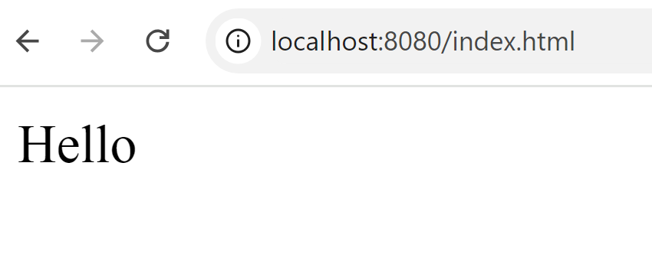

Run it …
Launch Server
Open Chrome Web Browser
Type url: http://localhost:8080/

Slide 26
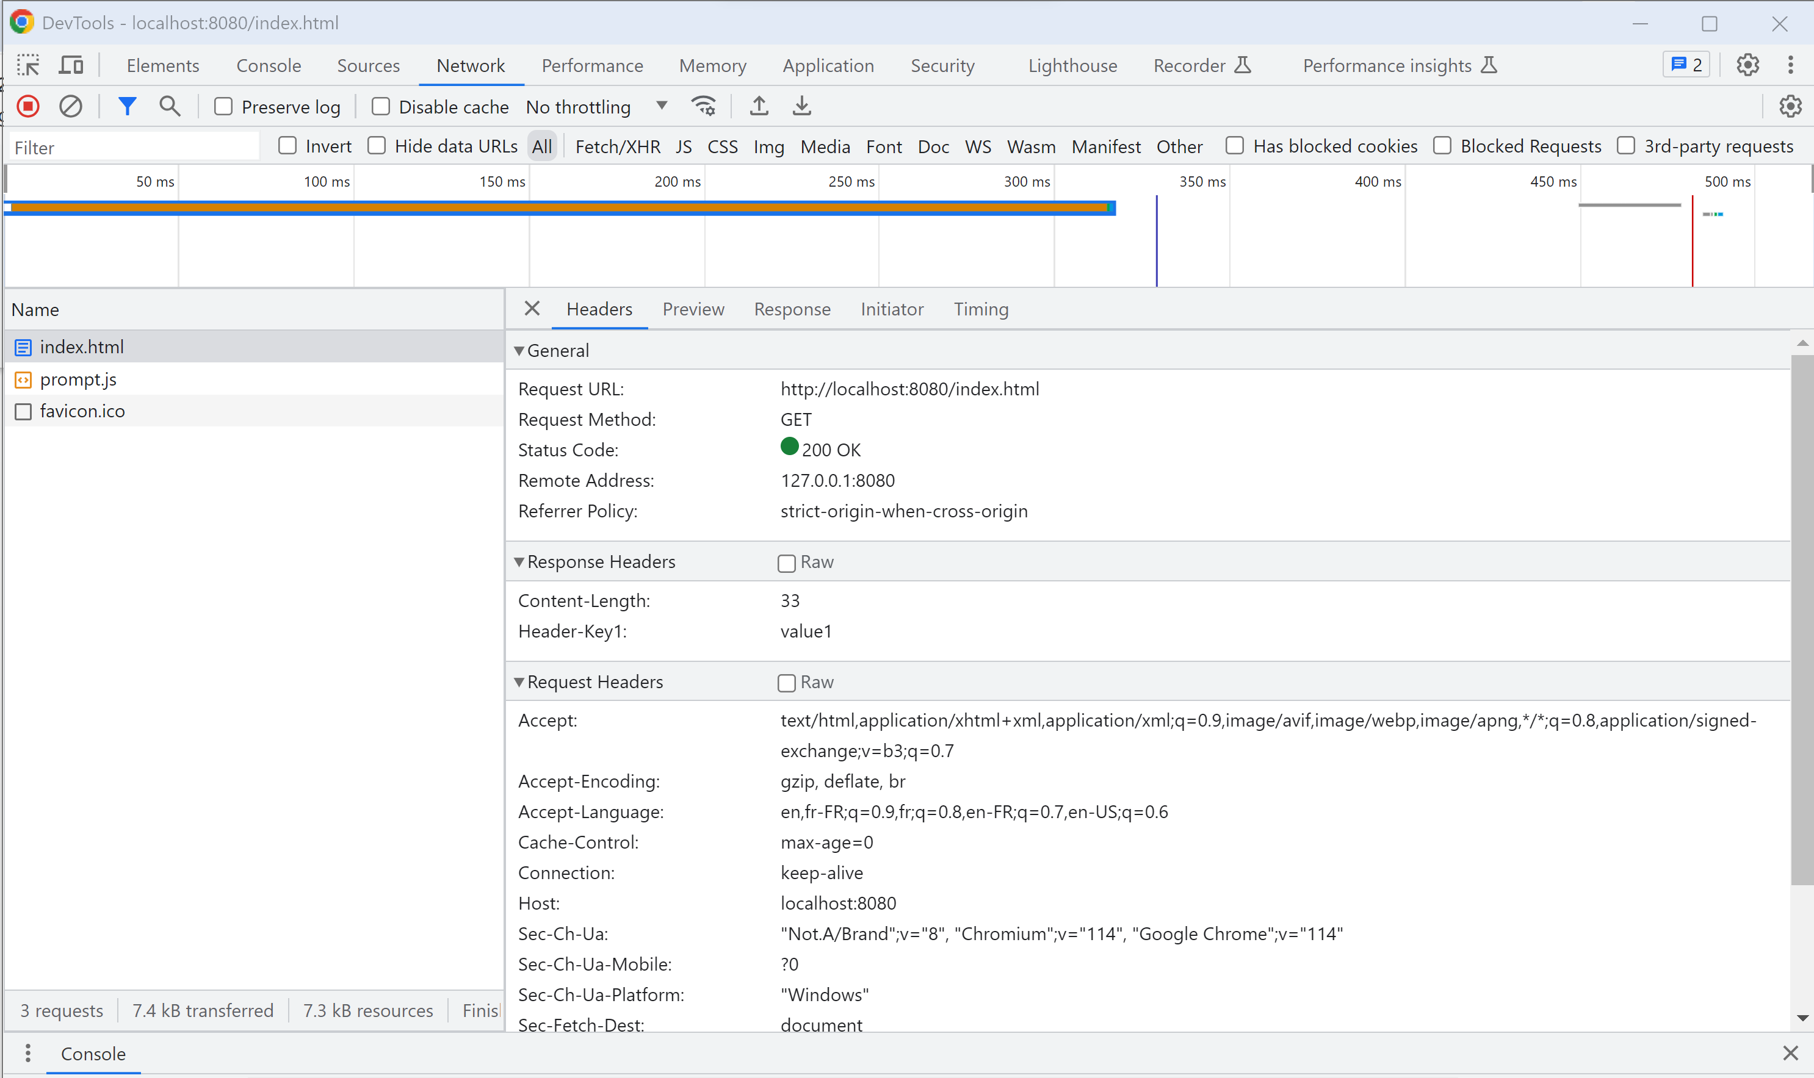
F12 (Chrome Debugger Tools > Network )

Slide 27
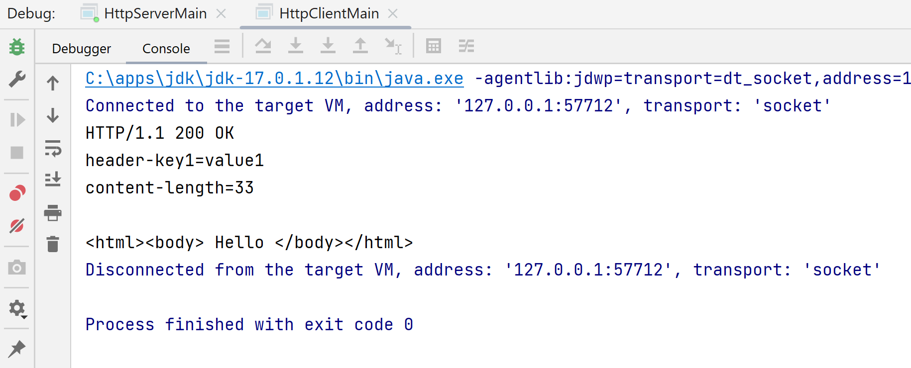
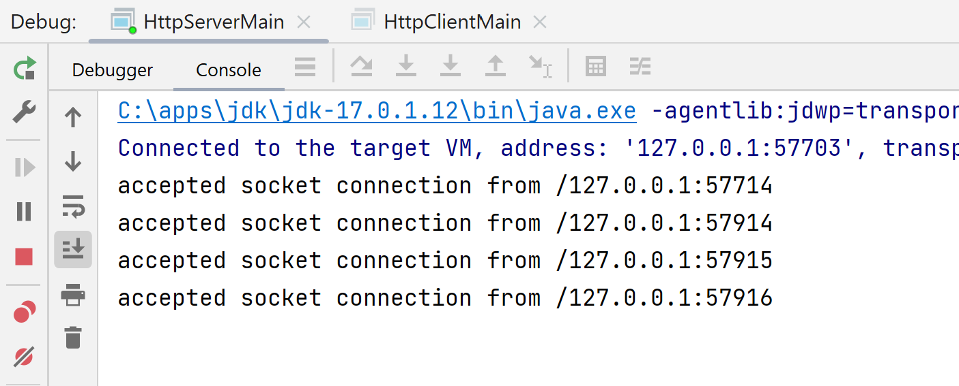
Debug Client & Server - Logs

Slide 28
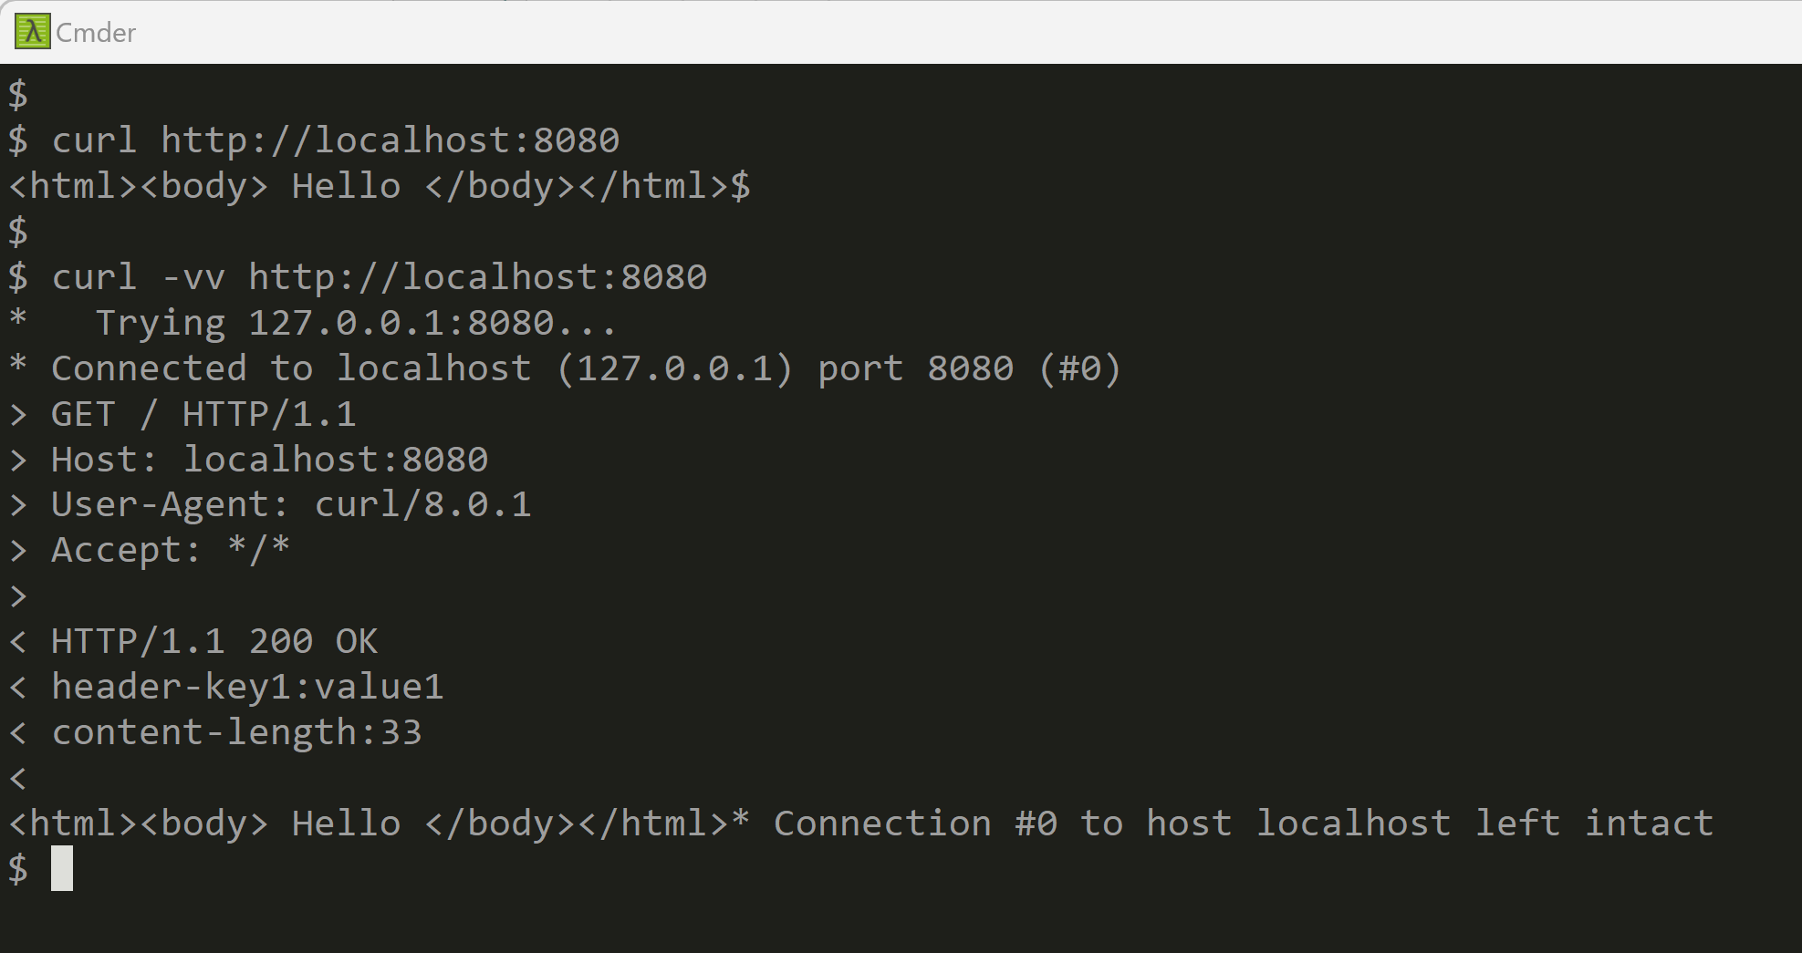
Test using Curl (or Postman)

Slide 29
ANNEXE … equivalent Server code using frameworks

Slide 30
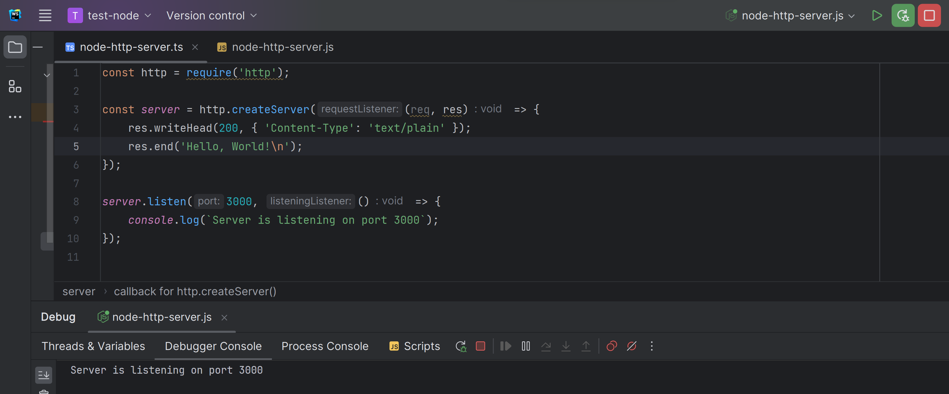
Minimalist NodeJs Server, using express

Slide 31
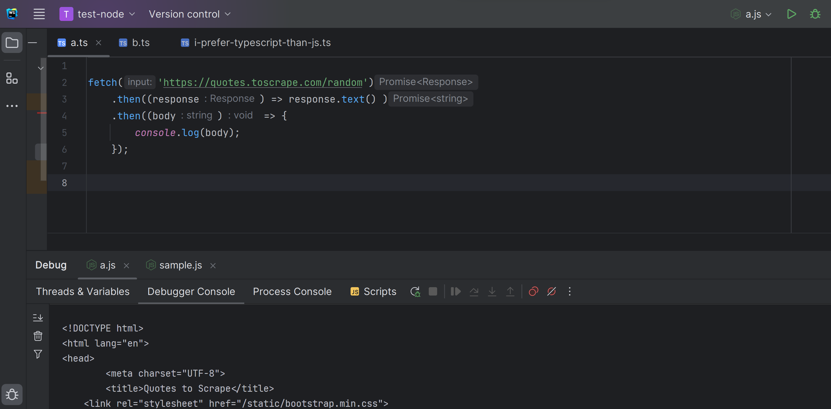
Minimalist NodeJs http Client fetch()

Slide 32
Minimalist Java Server … using SpringBoot = 1 line of code !!
Actually more « <xml> </xml> » in maven pom.xml than in java
And more java « @annotation »
than java « {code} » !!!
https://start.spring.io/

Slide 33
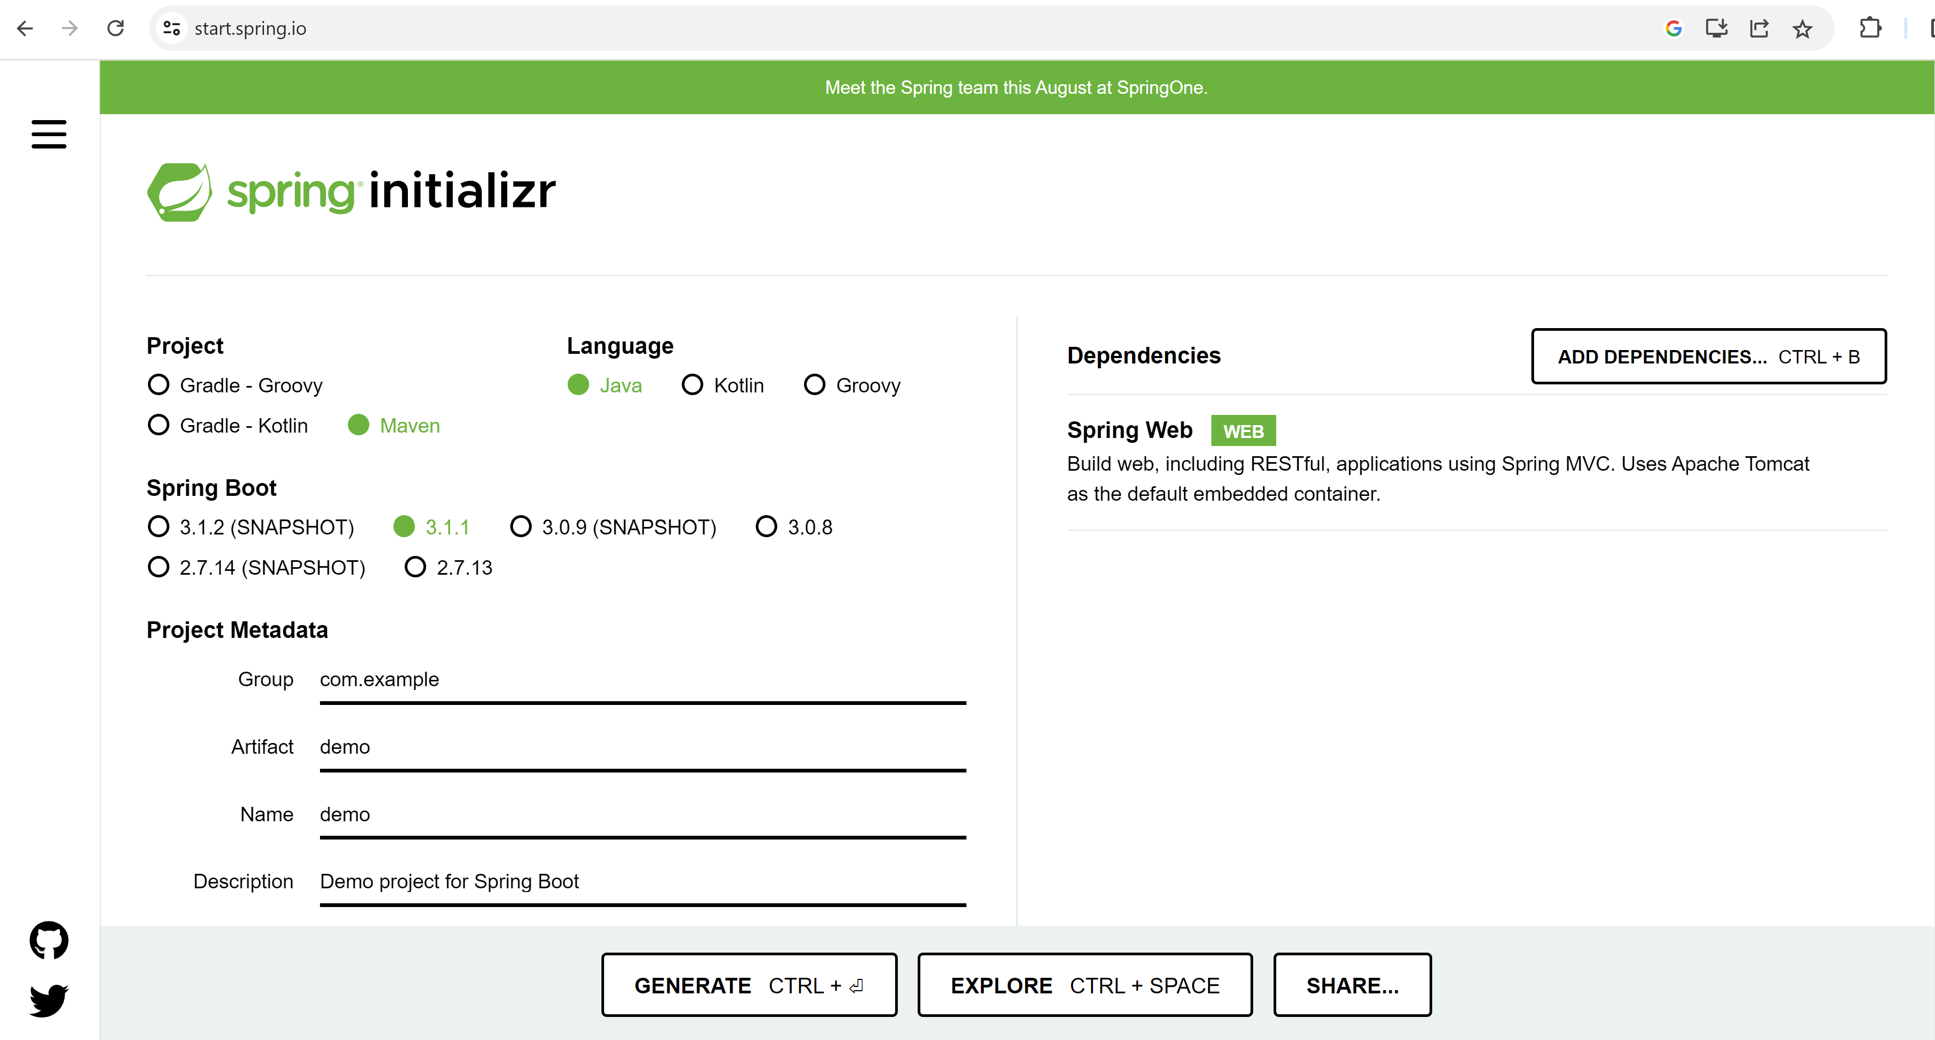
https://start.spring.io/ add dependency « WEB »

Slide 34
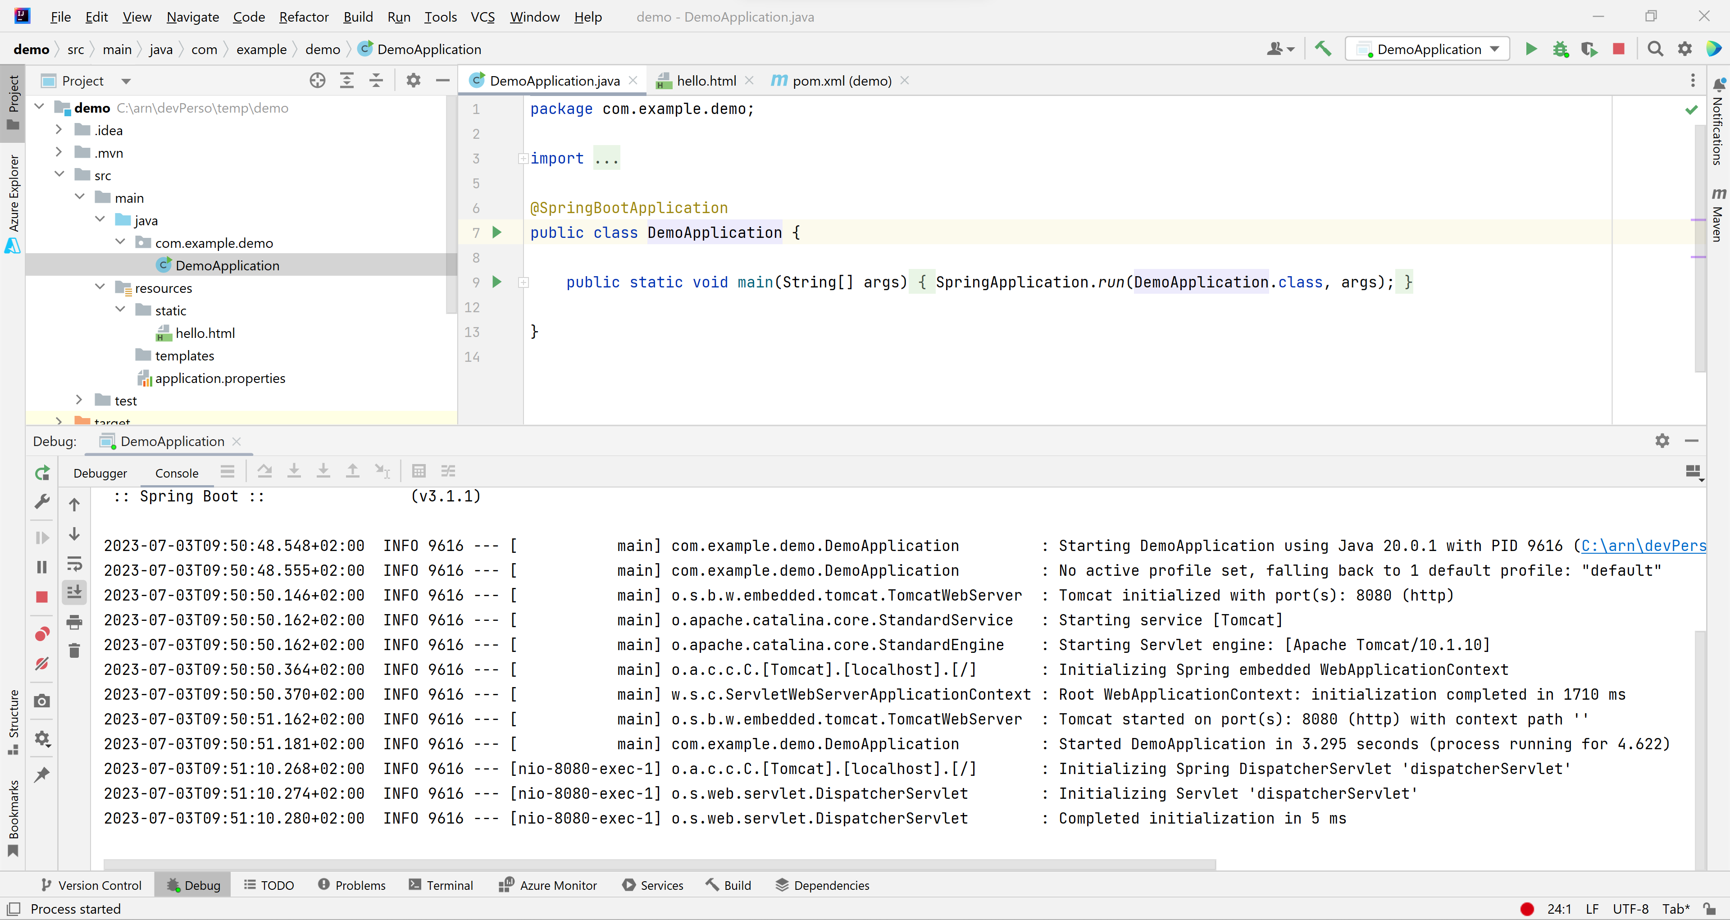
Click « Generate », Unzip, Import in IDE, Run

Slide 35
Coffee Break http Take Away
http(s) is a Simple protocol on top of TCP-IP
Extensible by Headers
Simple to write a Client / Server program
Widely used … The core of Web

Slide 36
More on http …
Theory:
Some Standard status code / headers imposed by W3C spec
Mostly FREE to choose URL, Header and Content
Practices:
How it is used in real life
Sample « type of servers »: Static CDN Pages, Dynamic Server Pages,
http Api Server (Rest json servers), Frontend/Backend N-Tiers architecture
Rest, web naming conventions & Best practices
Gateway, Virtual Hosts, Proxy, Security Proxy ...

Slide 37
Status Code Family: 200, 300, 400, 500
200, 201, 202 … = OK
300, 301, 302 … = maybe ok, but temporary unavailable, redirected..
400, 401, 402 … = ERROR on client-side
500, 501, 502 … = ERROR on server-side

Slide 38
Common http Status Codes https://developer.mozilla.org/en-US/docs/Web/HTTP/Status
303 = redirecting … example to login page (for authentication)
304 = not modified
401 = unauthorized (unauthencated)
403 = Forbidden
404 = Not Found (bad url or resource not exist)
500 = internal server error
502 = Bad Gateway
503 = Service Unavailable

Slide 39
http Method Verbs : GET, PUT, POST, DELETE, HEAD, PATCH, ..
GET = readonly to get a resource content (idempotent : can retry)
PUT = update an existing resource
(idem potent: will overwrite/update resource)
POST = create a new resource
(NOT idem potent: create a new one each time)

Slide 40
http Method Verbs (bis): GET, PUT, POST, DELETE, HEAD, PATCH, ..
DELETE = delete a resource by its id/path (idempotent : can retry)
HEAD = only get http headers corresponding to a resource
(idem potent) … fast checking if exist/modified since
PATCH = partial update of a resource
(maybe NOT idem potent on field insert, or idem potent on field update)

Slide 41
Simple case: http Rest Server responding ONLY *.html/*.js/*.css/*.png/… static page files
Terminology: Static Web Page Server
http request GET/HEAD
On resource /{filePath}
http Web Client
http Static Web Page Server
+ index.html
+ dir1/
+ index.html
+ page2.html
+ images/
+ image1.png
Example: Nginx, Apache, Github Pages, CDNs, …

Slide 42
Dynamic Page Server ( server-side generated web page)
Terminology: Dynamic Page Server
http request GET/POST/PUT/DELETE
On resource /{dynamicPage}/{id}?{query} {body}
Web Browser
http Dynamic Page Server
html page, generated on demand
Example: *.jsp, servlet, mvc view pages, …
Maybe also some static page.. (*.css, *.js, )

Slide 43




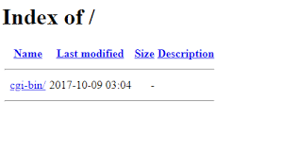



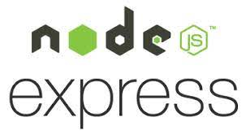

Museum of Dynamic Page Server Technologies
/htdocs / cgi-bin / *.sh
*.SP
Personal Home
Page
(not a decent langage)

Slide 44


Java Servlet & Jsp (html in java / java in pseudo-html )
= plain old java code printing « html » text
void toHtml(ServletOutputStream out) {
if (cond) {
out.print("<div> <span \"attr\"=\"v1\"> ..");
} else {
out.print("<div> <span \"attr\"=\"v2\"> ..");
}
out.print( new Date() );
}
= pseudo html/xml/markup code containing java
<% if (cond) { %>
<div><span "attr"="v1"> .. </span></div>
<% } else { %>
<div><span "attr"="v1"> .. </span></div>
<% } %>
<%= new Date() %>

Slide 45

Choose your poison Red pill / blue pill

Slide 46
Not only a Developper problem… Html+Js+CSS re-Rendering slowness + Network + .. for reloading pages links
SLOW … SLOW ….
NETWORK Bandwidth CONSUMING
+ Network Latency
+ CPU CONSUMING

Slide 47
Click <href> … RE-Loading new html page
Web Browser
/Page1.html
http GET /page1.html
<script>app1.js</script>
Free old page memory
http GET /page1.js
app1.js
Parse js
+ execute function init() {.. }
+ parse css + render html
http GET /page1.css
http GET /page1-image2.png
Dynamic Server Pages Server
CLICK on <href url=« /page2 »></href>
http GET /page2
/Page2
http GET /page2.js (or shared cached)
(re)Parse js
+ RE execute function init() {.. }
+ (re)parse css + RE render html
REPLACE page
with
new page
http GET /page2.css (or shared cached)
http GET /page2-image2.png (or shared cache)

Slide 48
Solution to Multiple Pages Application Problems ? caching + optims + workarounds … ? => SPA = Single Page Application !!

Slide 49
SPA = Single Page Application … still dynamic, still Multiple Rest Json requests
Web Browser
/Page1.html
http GET /page1.html
<script>app1.js</script>
http GET /page1.js
app1.js
Parse js
+ execute function init() {.. }
+ parse css + render html
http GET /page1.css
http GET /page1-image2.png
Web Server
CLICK on <button (click)=« callFunction() » >
http POST /api/restEndpoint1 {json}
REPLACE add/remote/update some <div>
Within SAME page
response {json}
http POST /api/restEndpoint2 {json}
response {json}

Slide 50
http API Server (cf Rest Api)
Terminology: Http Api Server
http request GET/POST/PUT/DELETE
On resource /{dynamicEntityPath}/{id}?{query}
Request body {json}
http Api Client
Http Api Server
response body {json}
Mostly *.json or *.xml !!!
Maybe also few (static) pages *.html,*.js,*.css

Slide 51
http exposing a « CRUD » api CRUD : Create – Read - Update - Delete
http protocol
SQL queries
(ex: jdbc protocol)
Create
http POST /{entityType} … body
INSERT into table T (..) values(..)
Read
http GET /{entityType}/{id}
SELECT * from T where id=?
http GET /{entityType}?field=value
SELECT * from T where … limit 10
Update
http PUT /{entityType}/{id} .. body
UPDATE T set …=? where id=?
Delete
http DELETE /{entityType}/{id}
DELETE T where id=?

Slide 52
using Standard naming convention on Verb + Url = follow « Rest » style Rest = Representational State Transfer
http request GET/PUT/POST/DELETE/..
On resource /{path}/{entity}/{id}
http Rest Client
http Rest Server
Corresponding CRUD
action on resource
(in database):
SELECT/UPDATE/INSERT/DELETE

Slide 53
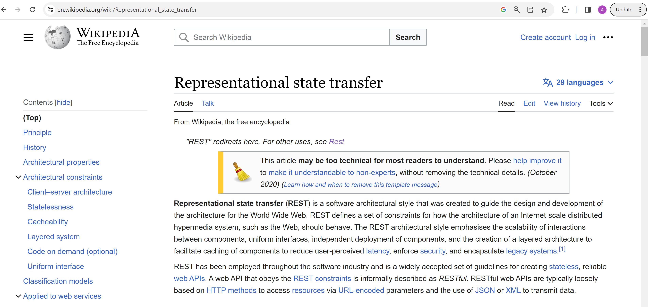
https://en.wikipedia.org/wiki/Representational_state_transfer

Slide 54
Rest-Json Api server in Springboot @Mapping ..
http endpoint
java rest controller class
http Request
java method
json request body
Java bean method parameter
json response body
Java bean method return

Slide 55
Example @RequestMapping
http PUT /api/endpoint1/meth2
header1:value1
{
« reqField »: « value»
}
class RequestDTO {
public String reqField;
}
Json -> java
@RestController
@RequestMapping(« /api/endpoint1 »)
public class MyRestController {
@PutMapping(« meth2»)
public ResponseDTO handle( @RequestBody RequestDTO req) {
return new …
}
}
http 200 OK
header2:value2
{
« respField »: « value»
}
Java -> json
class ResponseDTO {
public String respField;
}

Slide 56
Example using NodeJs - Express
const express = require('express’);
const app = express();
app.get('/', function (req, res) {
res.send({ some: 'Hello Json Express’ })
});
app.listen(3000);

Slide 57
Mixing Static and Dynamic Content
when static requests
/static/**
*.html
*.js
*.css
*.png
Web Browser
Step 1 : http GET /static/index.html
Web Server + Rest Api
<html><script>/static/app.js</script>
Step 2 : http GET /static/app.js
When dynamic request
/api/**
app.js call XmlHttpRequest.post({json})
Step 3,4..N : http PUT /api/{restEndpoint} {req}

Slide 58
Gateway … Ingress Rule
CDN Server
(example apache, nginx, github)
If « /path » start with « /static »
/static/**
*.html
*.js
*.css
*.png
Gateway HTTP
Server + rules
when static requests
http {verb} /{path}
If « /path » start with « /app1 »
Rewrite request to /app1
http Api Server 1
(example: Java springboot in K8s)
Db1
Example:
route 53 on AWS
Ingress rule on K8s (+Nginx)
If « /path » start with « /app2 »
Rewrite request to /app2
Db2
http Api Server 2

Slide 59
in Angular Development Environment .. « Ng serve »
« Ng serve » has 1 , 2 or 3 roles !
Role 1 : basic development: serve static local files (*.html, *.js, *.css … compiled from *.html, *.ts, *.sccs )
Role 2 : for unit testing « mock server » requests in *.json /api/* in app/server/*.ts
Role 3 : proxy to backend (eg. java)
requests in *.json /api/* redirected to backend api

Slide 60
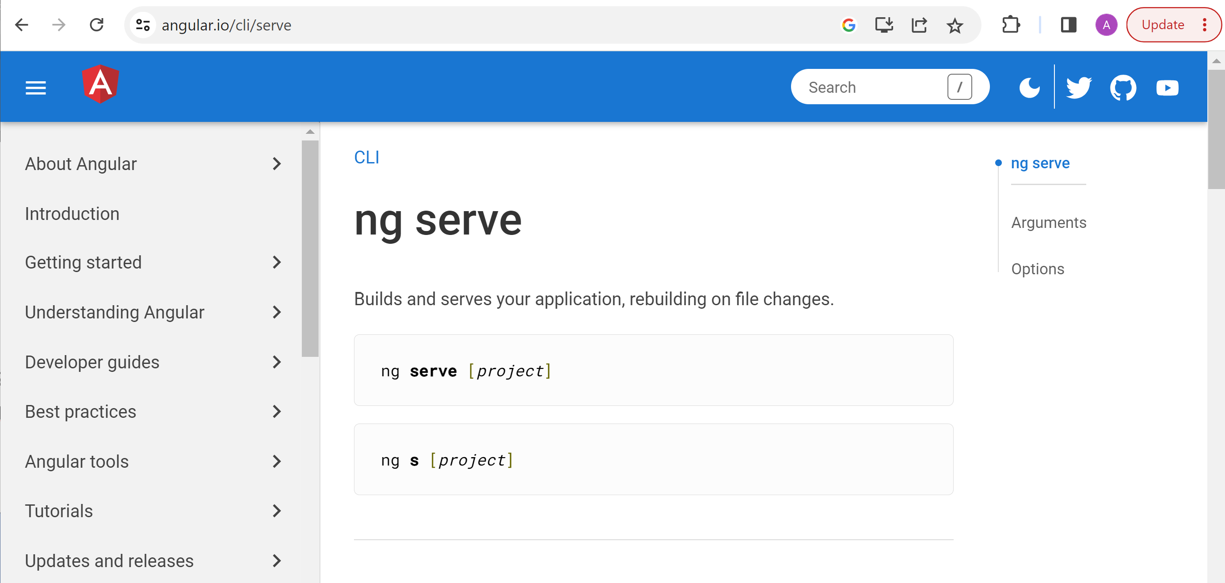
https://angular.io/cli/serve

Slide 61
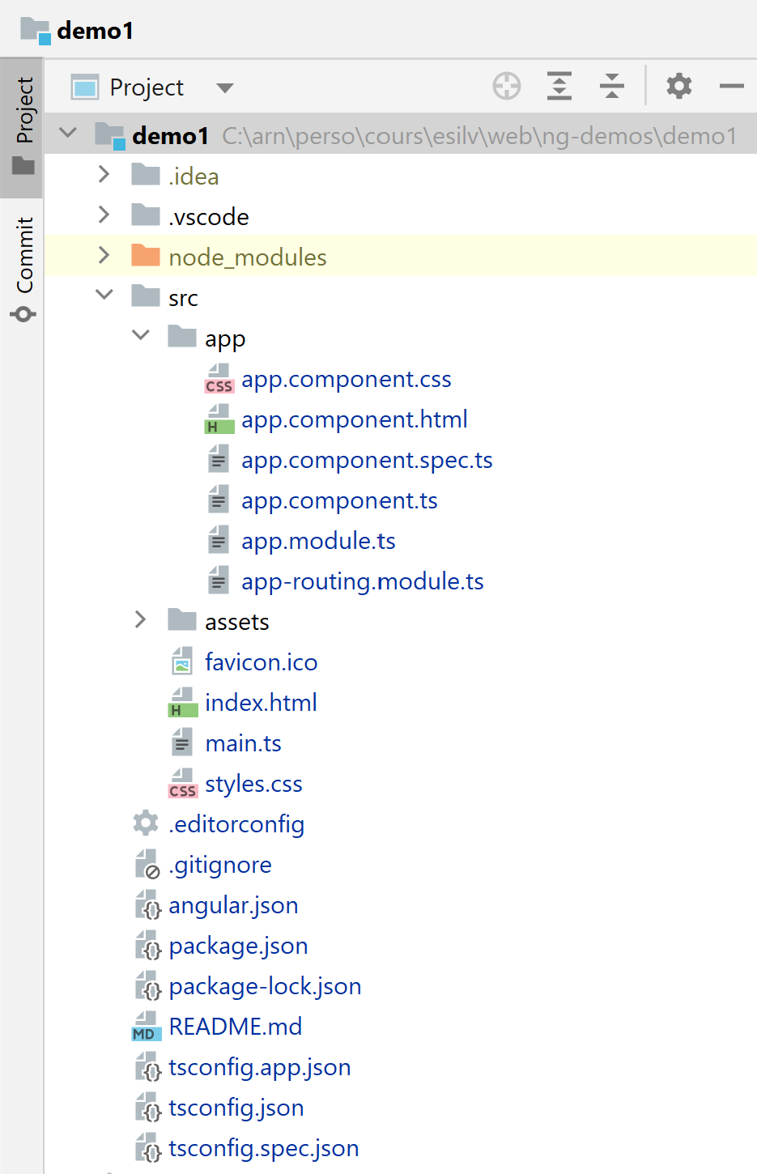
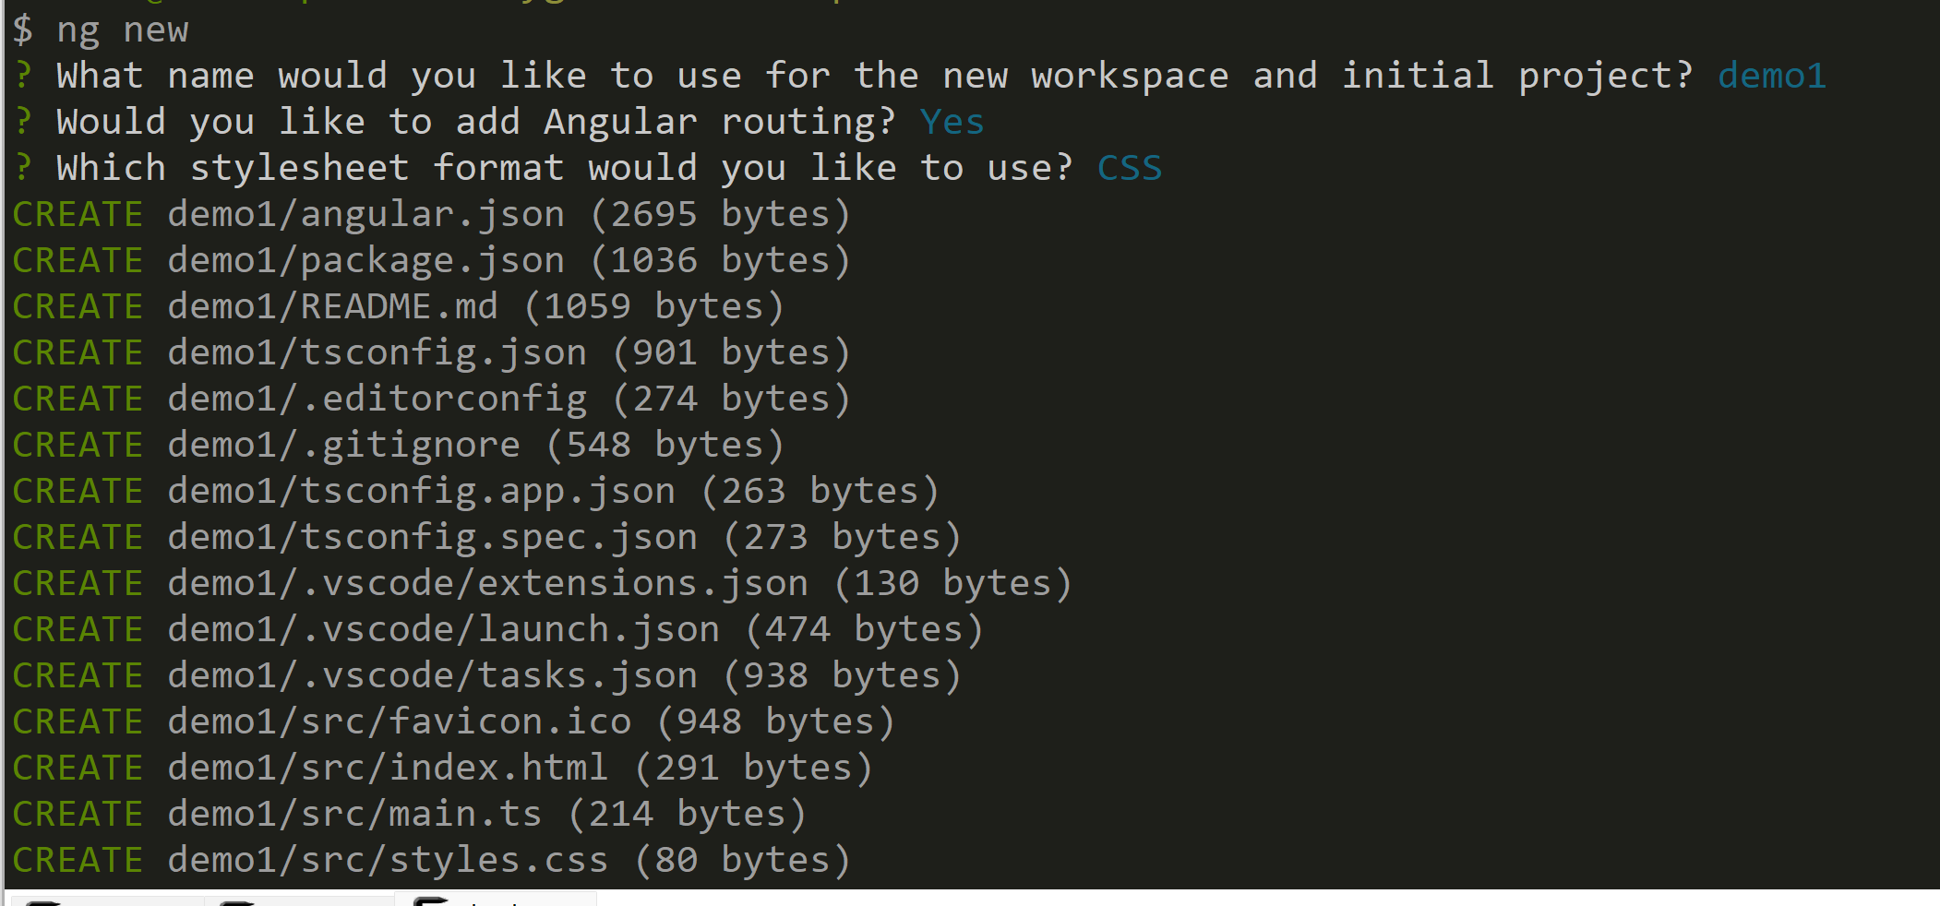
(pre-requisite) npm install -g @angular/cli ng new

Slide 62
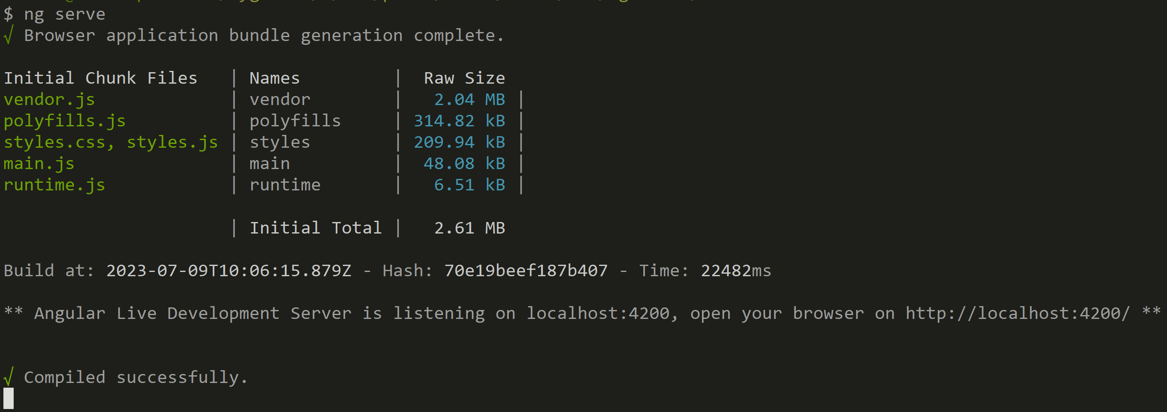
ng serve => http://localhost:4200 … live-reload on *.html, *.ts

Slide 63
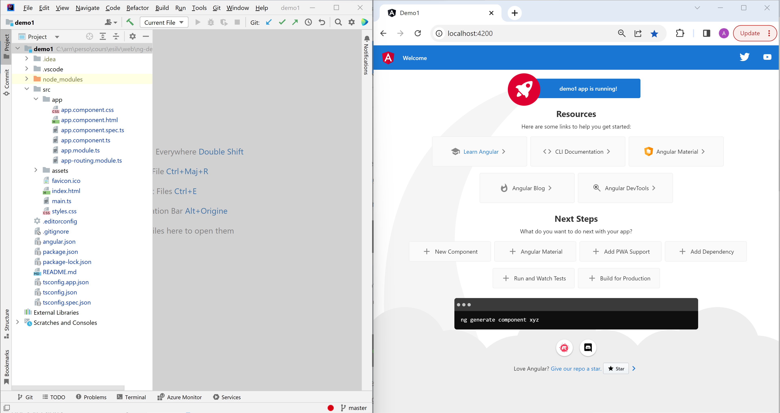
Demo IntelliJ (left) + Chrome (right) + ng serve

Slide 64
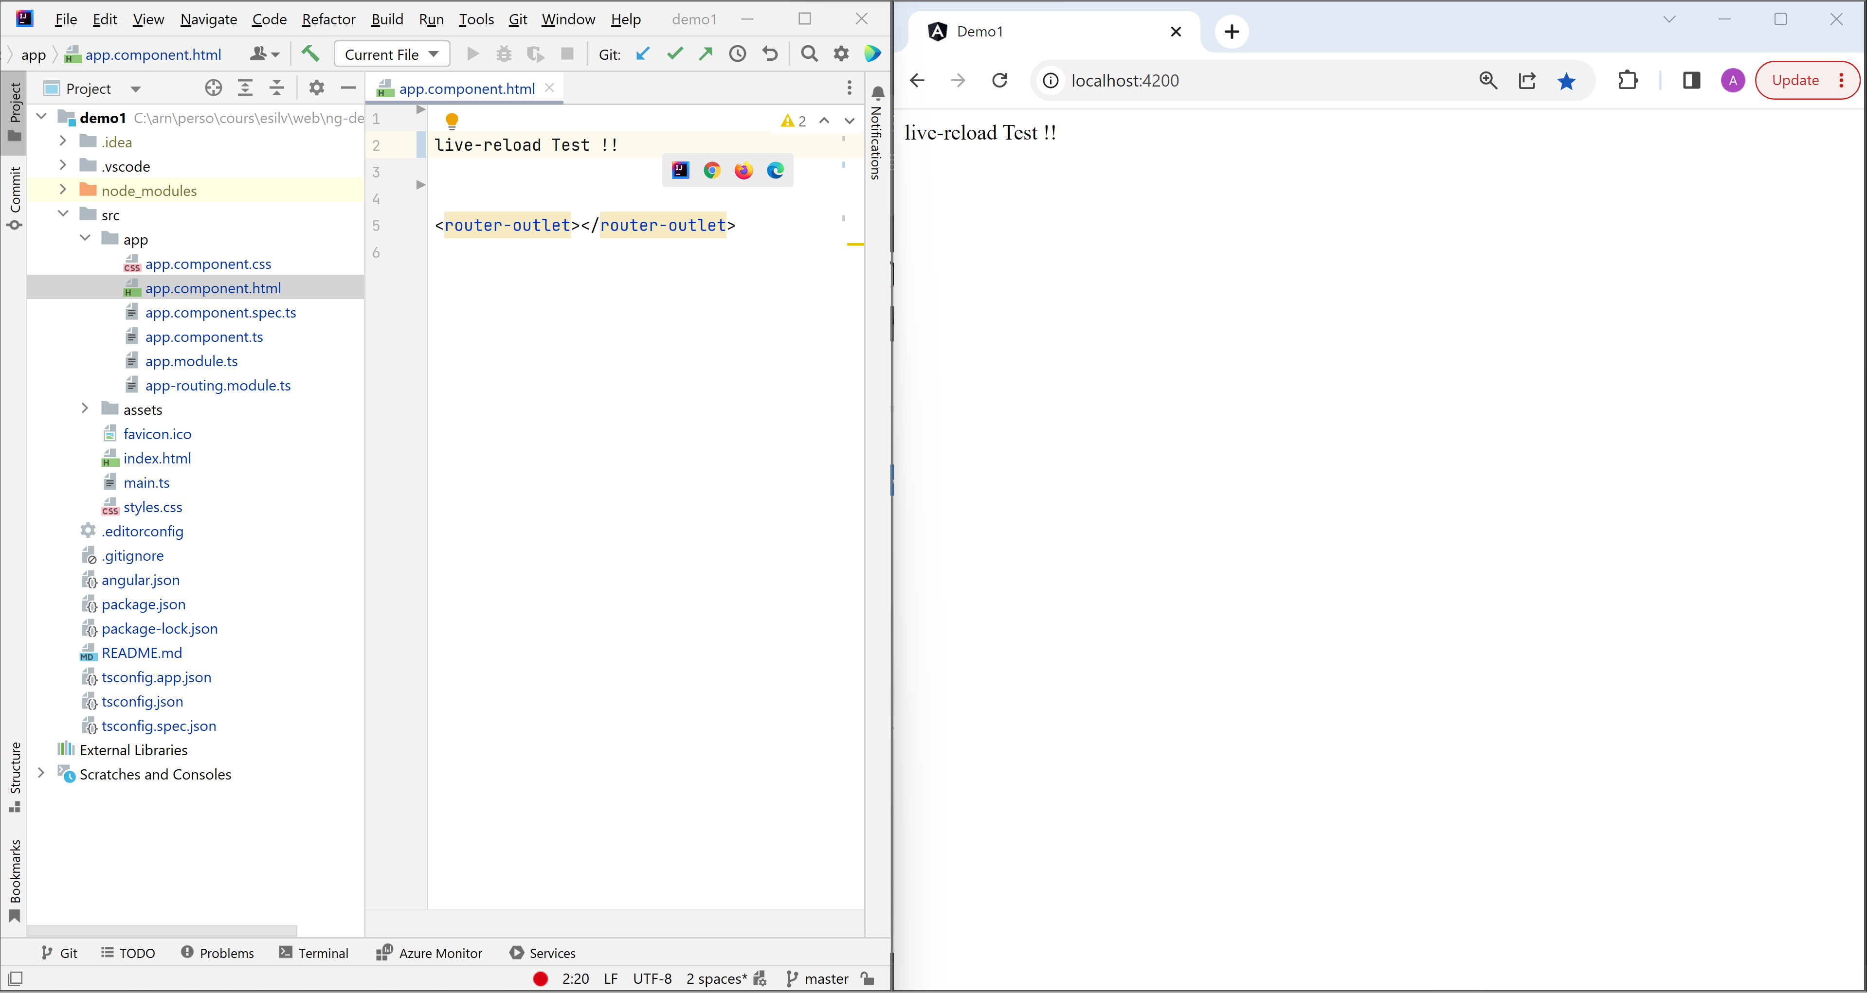
Demo … Live reload

Slide 65
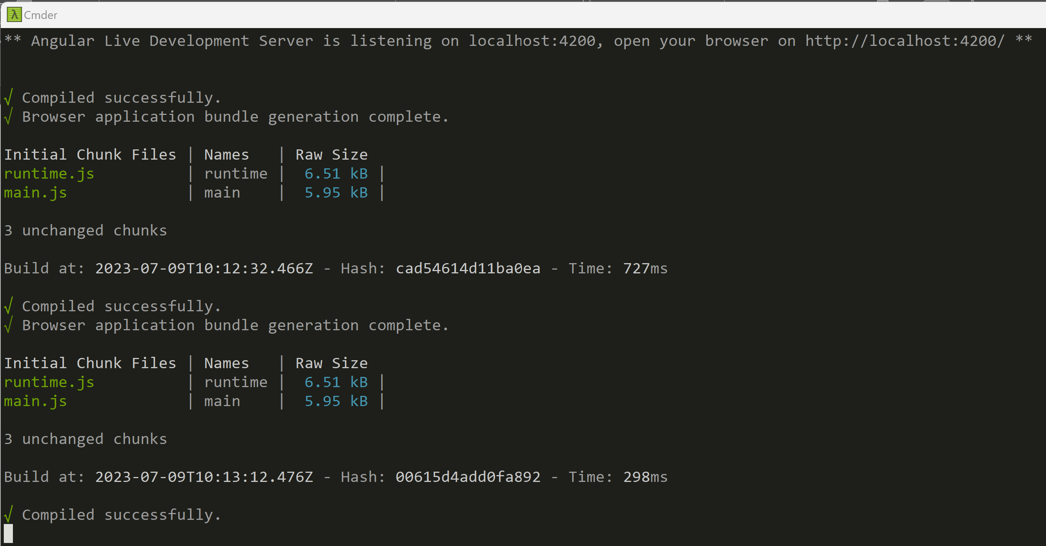
Live Reload … --watch and compile !!

Slide 66
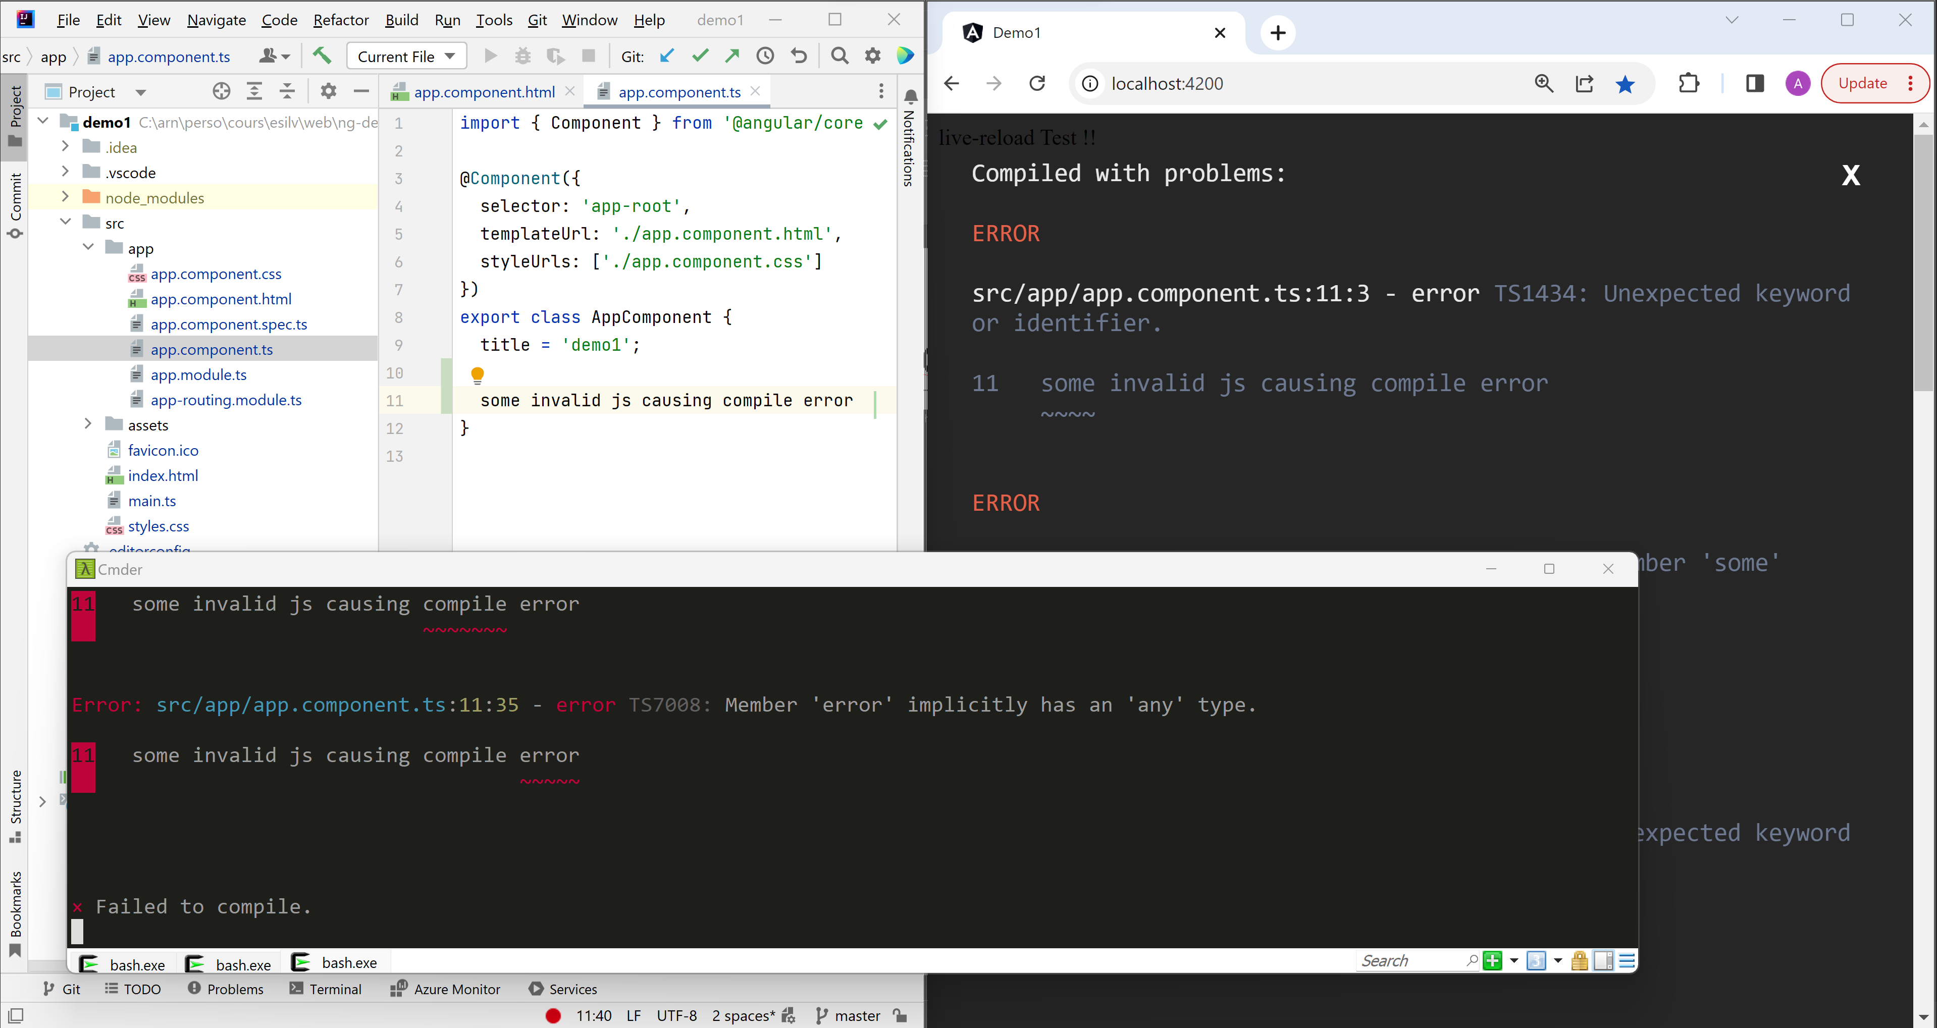
Demo live-reload … when compile error

Slide 67
Ng serve… why Mock « app/server/*ts, *.json »
Because …
Web developper/designer can start working in parallel without backend !!
Real backend
ng serve
@Get(« /path/entity1 »
handler() {
NOT IMPLEMENTED YET
}
static *.html,*.js
app/server/
*.ts
static *.json response body
{json response for /path/entity1}
{json response for /path/entity2}
{json response for /path/query1}

Slide 68
Ng serve… why Proxy to /api/** ? => CORS Origin problem !
Because … Web Browser blocks calls to « http://localhost:8080/api/** »
not comming from same « origin domain » as « http://localhost:4000/index.html » «app.js » !
ng serve
Web Browser
static *.html,*.js
:4000
conf/proxy.json (or .js) redirect /api/**
to localhost:8080/api/
Backend server
:8080
Blocked: CORS origin

Slide 69
Virtual Host … same IP address, different « Virtual » Server Hosts
http {verb} /{path}
Headers…
« host=virtual-host1 »
HTTP Server
(single IP address … several virtual hosts)
$ nslookup virtual-host1 => sharedIP
If header « host » = « virtual-host1»
handleRoute1() { ..}
$ nslookup virtual-host2 => sharedIP (same!!)
1 IP address
ONLY !!!
If header « host » = « virtual-host2»
http {verb} /{path}
Headers…
« host=virtual-host2 »
handleRoute2() { ..}
DNS server
Examples:
Apache virtual host
K8s ingress host
DNS entry1: virtual-host1=sharedIP
DNS entry2: virtual-host2=sharedIP

Slide 70
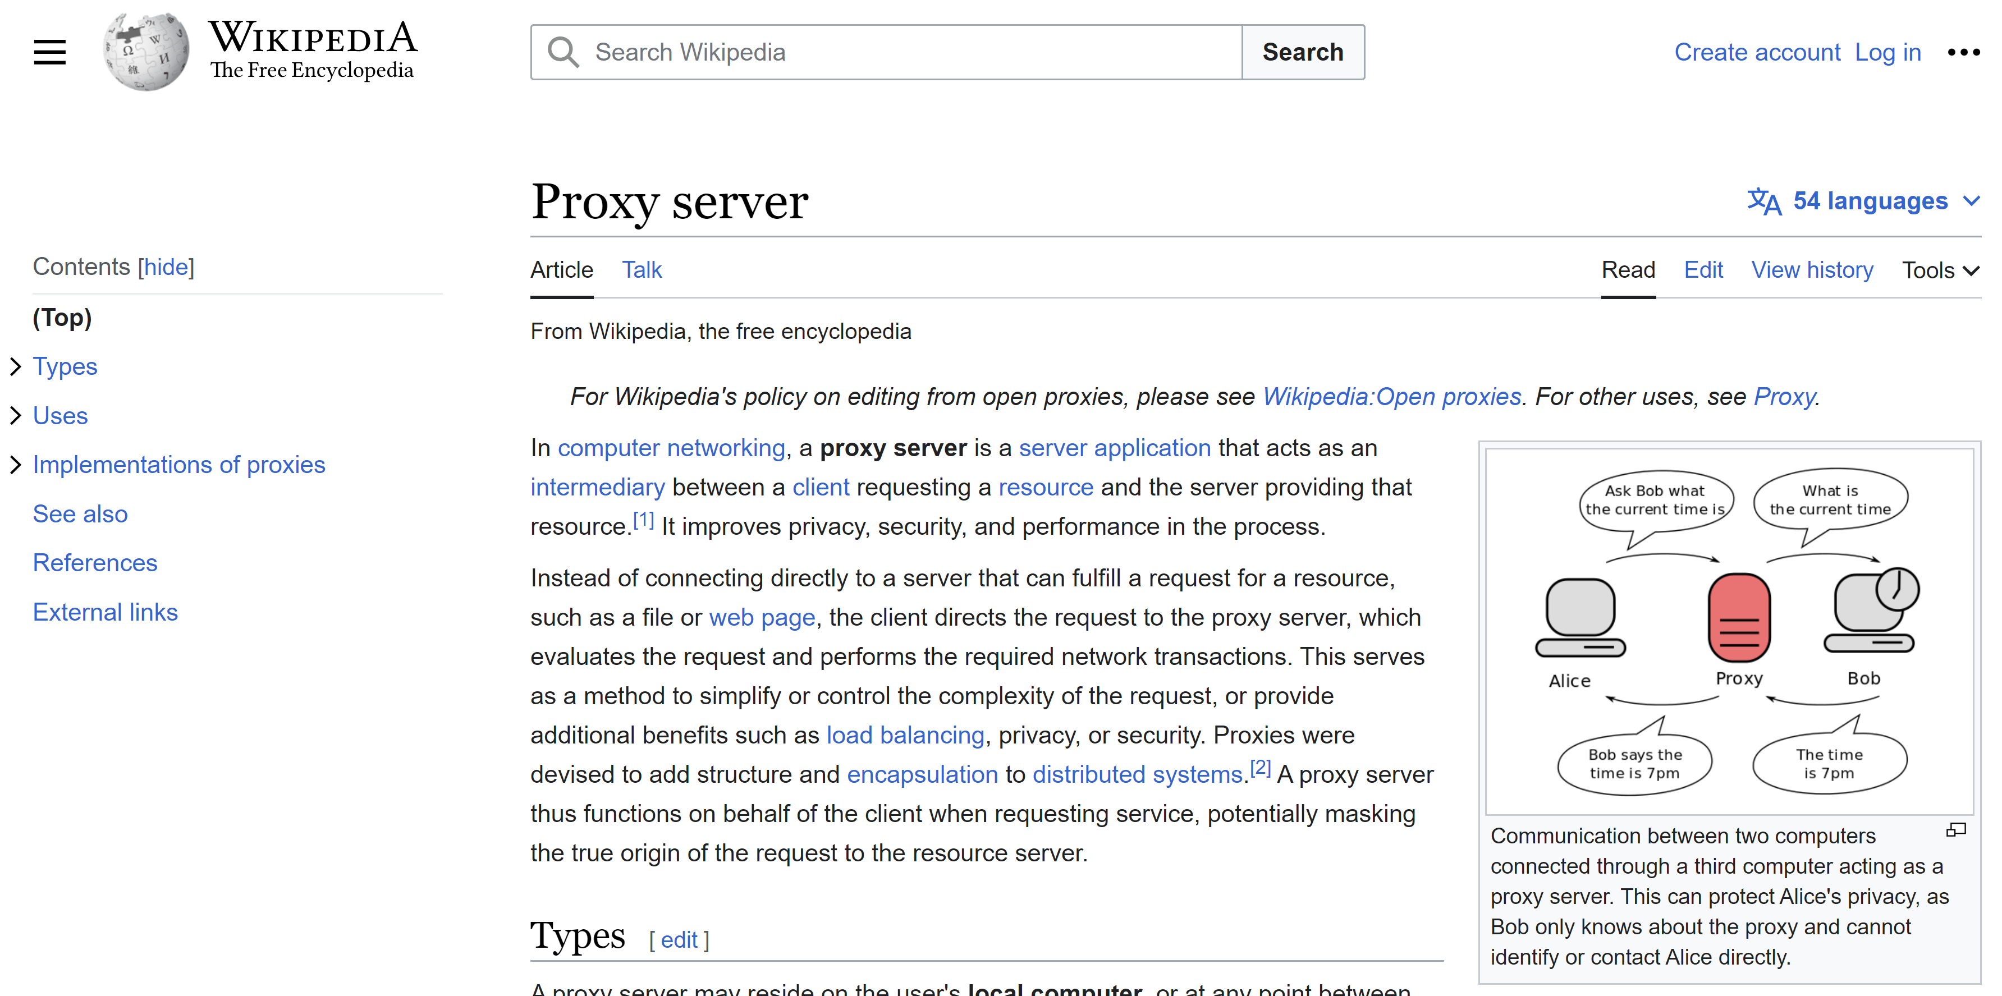
Proxy Server

Slide 71
Forward Proxy … Reverse Proxy ??
Some Terminology…
« Reverse Proxy » = transparent proxy = Gateway looks like a standard server ( not seen as a http or socks proxy)
Example: Used for loadBalancing, ingress in K8s « Forward » proxy: use explicit « X-Forwarded-For » http header for intranet security + firewall + authentication..

Slide 72
Http Proxy
The proxy becomes a http client for the target server
http {verb} /{path}
http Header:
http Target Server
http {verb} /{path}
http Header:
«X-Forwarded-For= host »
Http Proxy
http client
Use http header value
To DYNAMICALLY
Choose real host to connect to
(no static rules)

Slide 73
Example Intranet http « Security Proxy »
Enterprise Intranet (firewall restriction)
External Internet
Http Proxy
Employees
Web Browser
http GET /unsecure-site/virus.exe
http POST /confidential-data
unauthorized sites restriction
Virus SCAN
Data Leakage protection
Audit access log

Slide 74
Using « Transparently » a http Proxy
$ export HTTP_PROXY=http://proxyhost:8080
$ curl http://www.google.fr
=> use TCP-IP connection to « proxyhost » for all queries,
And rewrite http request to add header « proxy=www.google.fr»
HTTP_PROXY is standard environment variable
There are also standard configuration file for many applications (example: <proxy>..</proxy> in maven settings.xml
And custom args per langage, example « java –Djava.net.proxy.http=proxyhost your-app.jar »

Slide 75
Using « Transparently » an http request enricher Proxy … authenticating
$ export HTTP_PROXY=localhost:3128
=> typically to use NTLM authenticating local proxy
… to connect to enterprise Internet proxy
Using your enterprise Windows account + NTLM token

Slide 76
Px-proxy
My localhost Workstation
http GET /host..
Headers…
User = your windows login
token = your NTLM token
Intranet
Security Proxy
My Web Browser
http GET /host..
Header… none
Local px-proxy
Get your windows
Login + NTLM token
Check authenticated
windows login + token
Checking permission
Authorized to
GET/PUT/POST
To External web sites x,y,z
Active Directory

Slide 77
Summary
http protocol = Simple Text protocol + extensible Headers on top of TCP-IP
Few standards and norms: status code, header, cors origin
Types of servers:
Static pages server
Dynamic server-side pages (legacy)
Api server (Rest Json)
Mixed content : Gateway (Ingress Rules), Virtual Hosts
Proxies
Local development server: ng serve

Slide 78
Next course / Hands-on Pre-requisite to install on your PCs:
IDE
Runtime
Nodejs
(+ npm)
Tool
@angular-cli
(npm module in PATH)
Higly recommended :
WebStorm (or Visual Studio Code)
WebStorm = JetBrain ~IntelliJ for Web
also Included in « Intellij Ultimate »
But not in « Intellij Community »

Slide 79
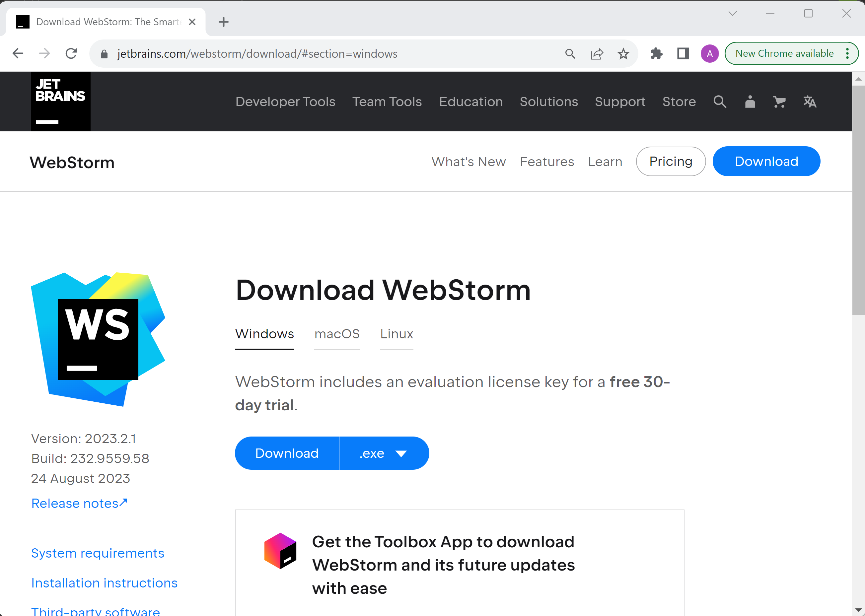
Pre-Requisite Install 1/3 : WebStorm 30 days free trial https://www.jetbrains.com/idea/download

Slide 80
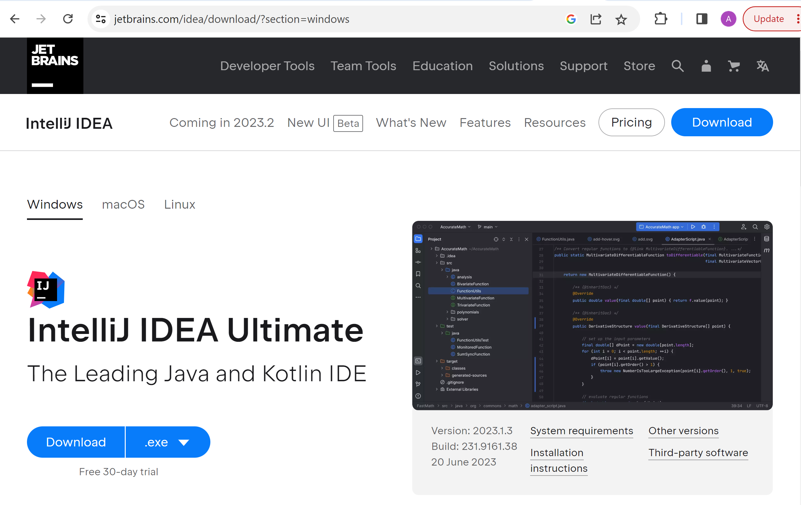
((( OR equivalent … IntelliJ Ultimate 30 days Free trial https://www.jetbrains.com/idea/download )))

Slide 81
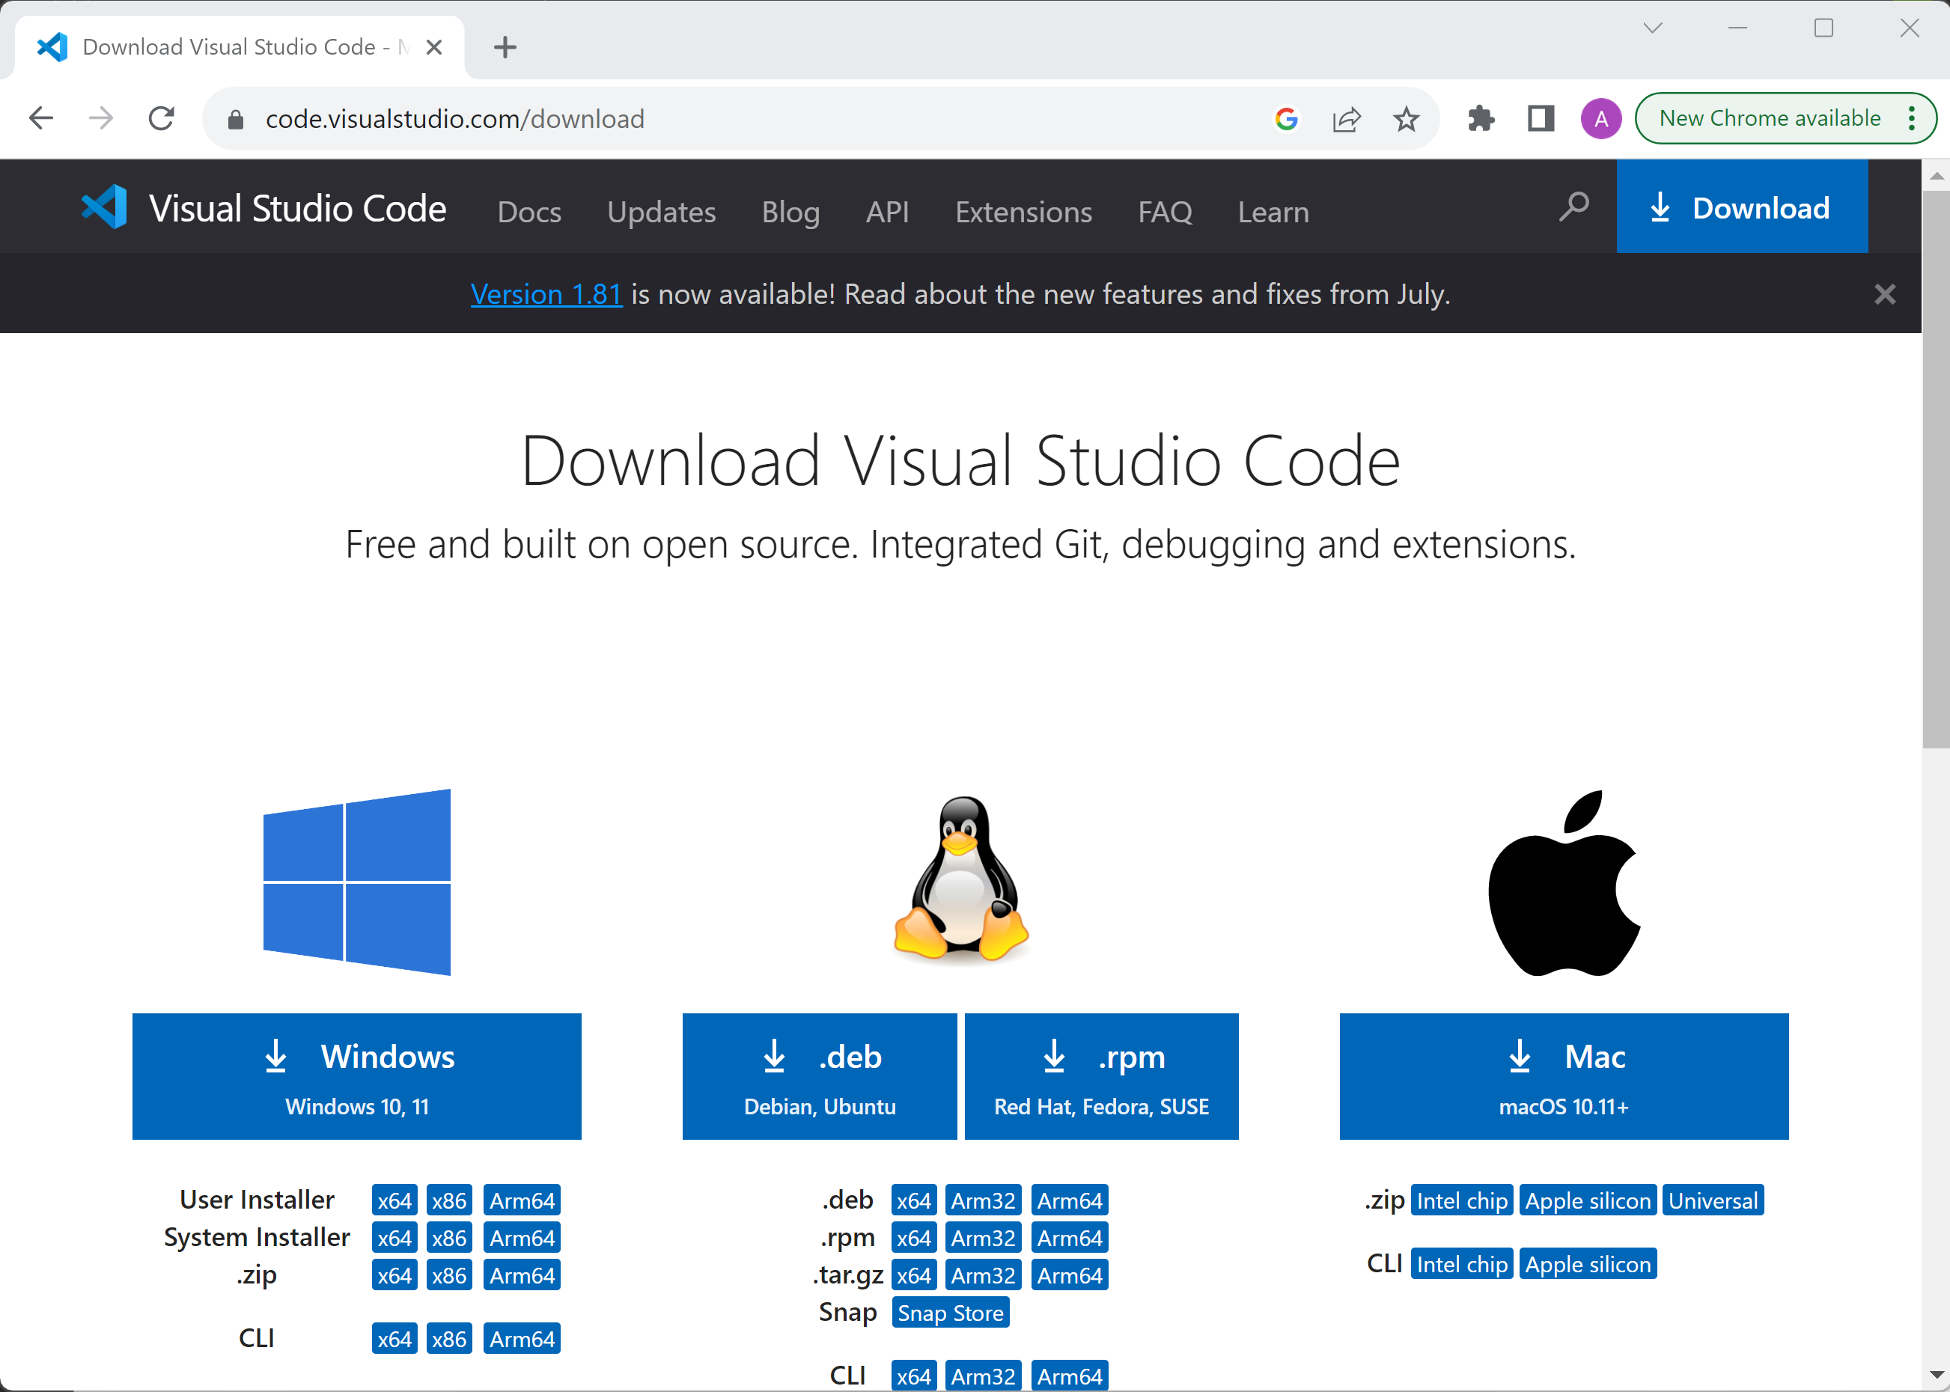
OR … Eclipse with *Web plugins OR … VisualStudio Code

Slide 82
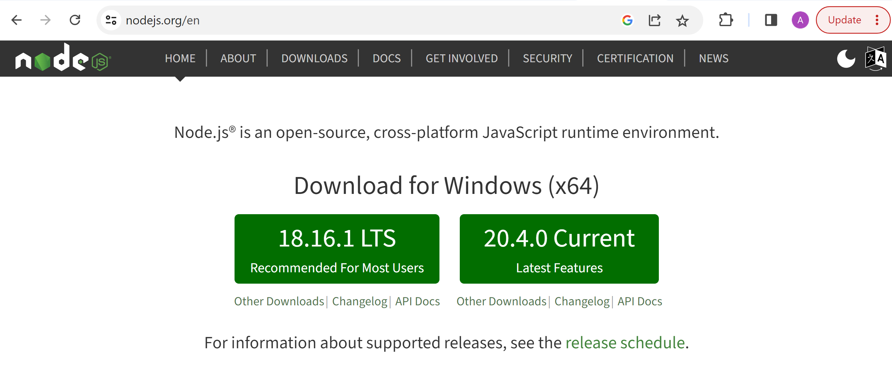
Pre-Requisite Install 2/3 : Nodejs https://nodejs.org

Slide 83
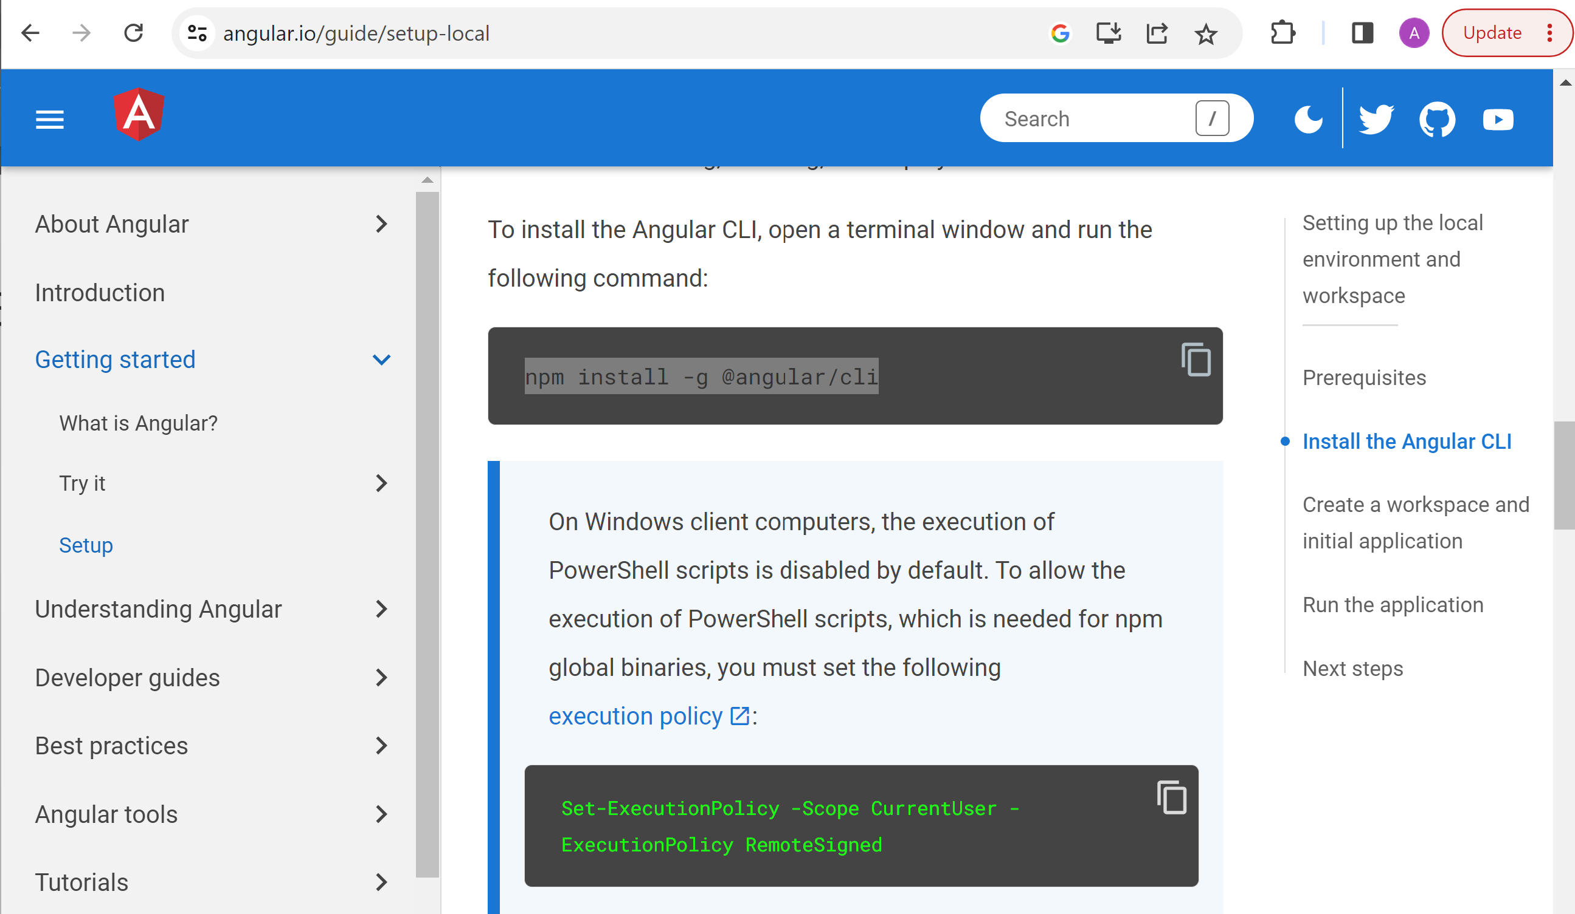
Pre-Requisite Install 3/3 : @angular/cli

Slide 84
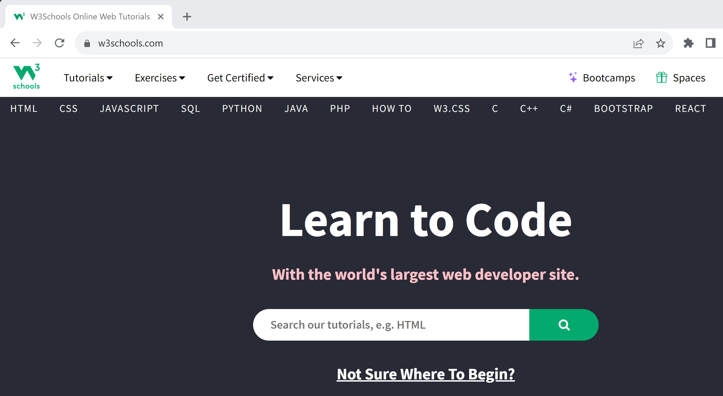
Suggested Reading for Next Time
https://www.w3schools.com/
HTML + JavaScript + TypeScript + NodeJS + Angular …

Slide 85
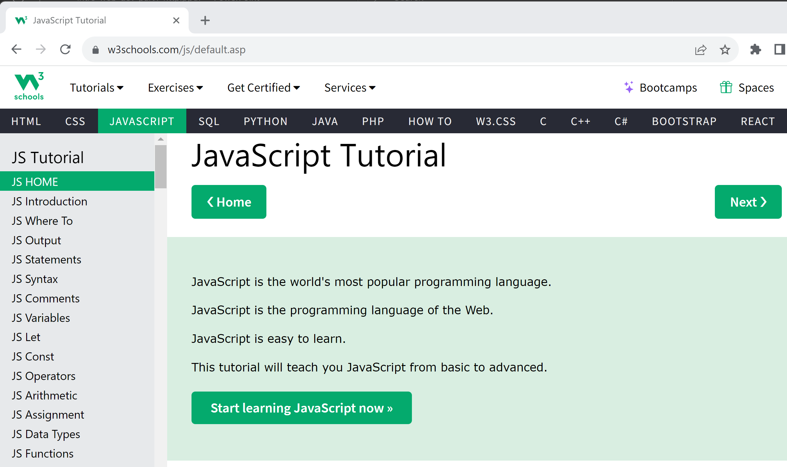
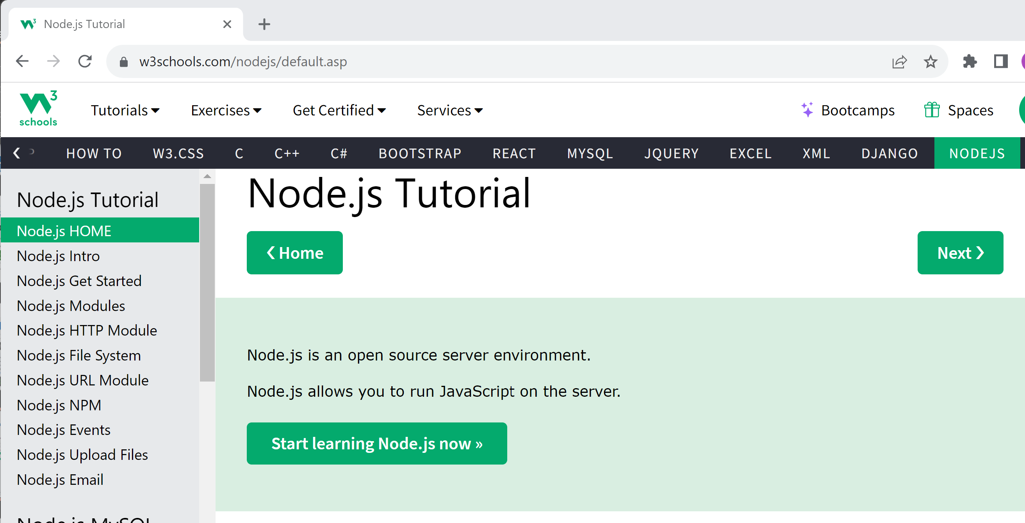
Suggested Reading for Next Time
https://www.w3schools.com/js
https://www.w3schools.com/nodejs

Slide 86
Questions ?

Slide 87
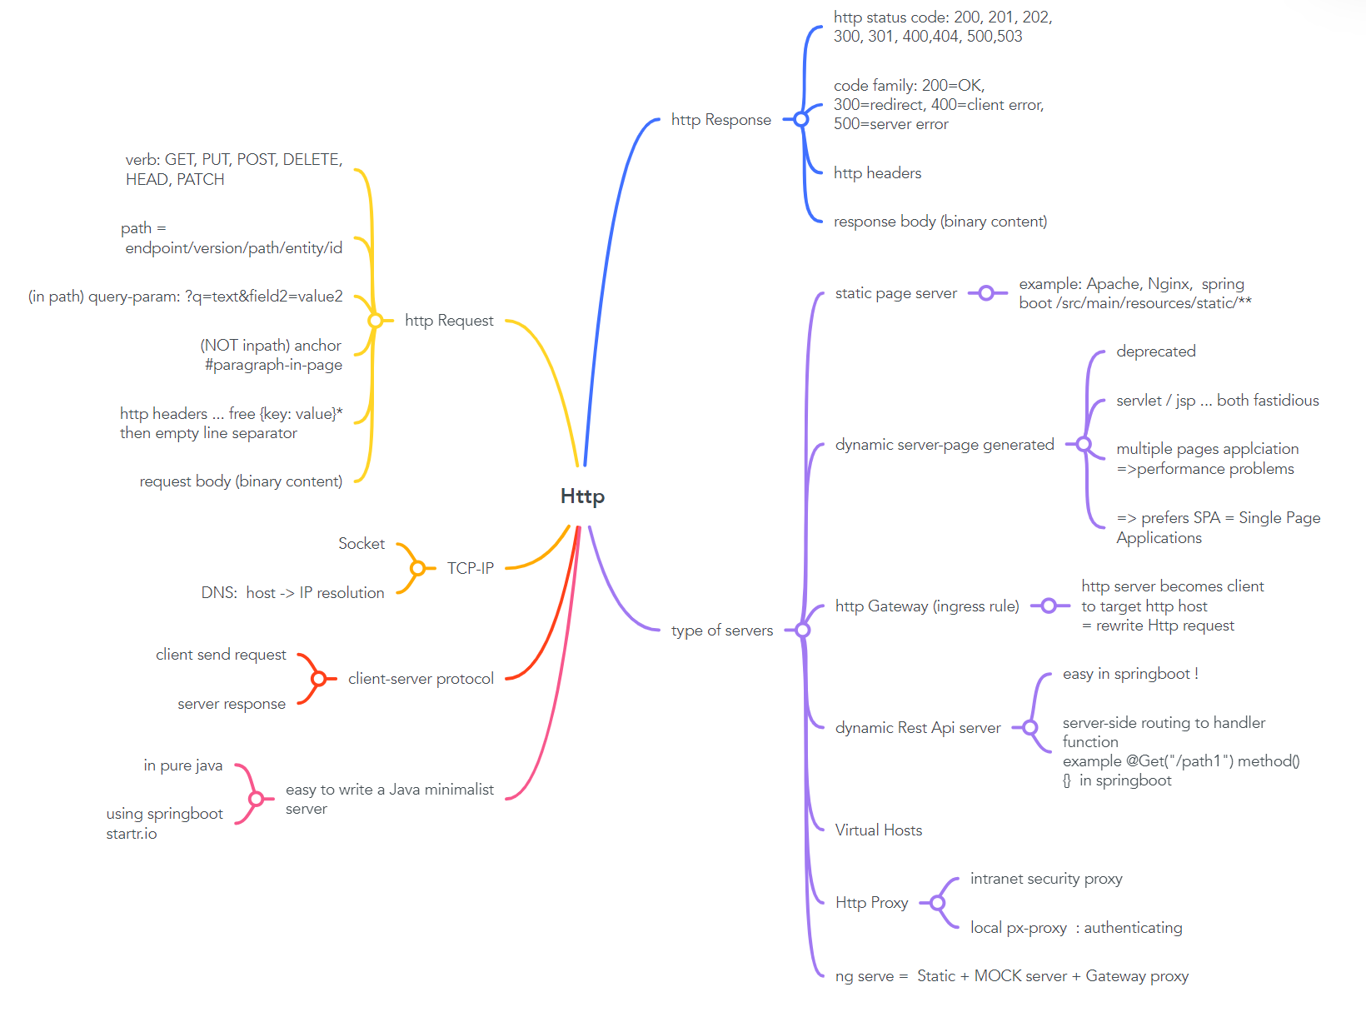
MindMap to Take Away https://mm.tt/app/map/2853349794?t=AFOnMZf7Ku

Slide 88
Links
arnaud.nauwynck@gmail.com
Course Esilv 2023
This document: https://github.com/Arnaud-Nauwynck/presentations/web/ intro-web-dev-part1-http.pdf

